Slide 1
From MITRE ATT&CK to SPARTA 1.MITRE ATT&CK
崑山科技大學 雲端運算暨資通安全研發中心主任
指導老師:曾龍
學生:董宸維

Slide 2
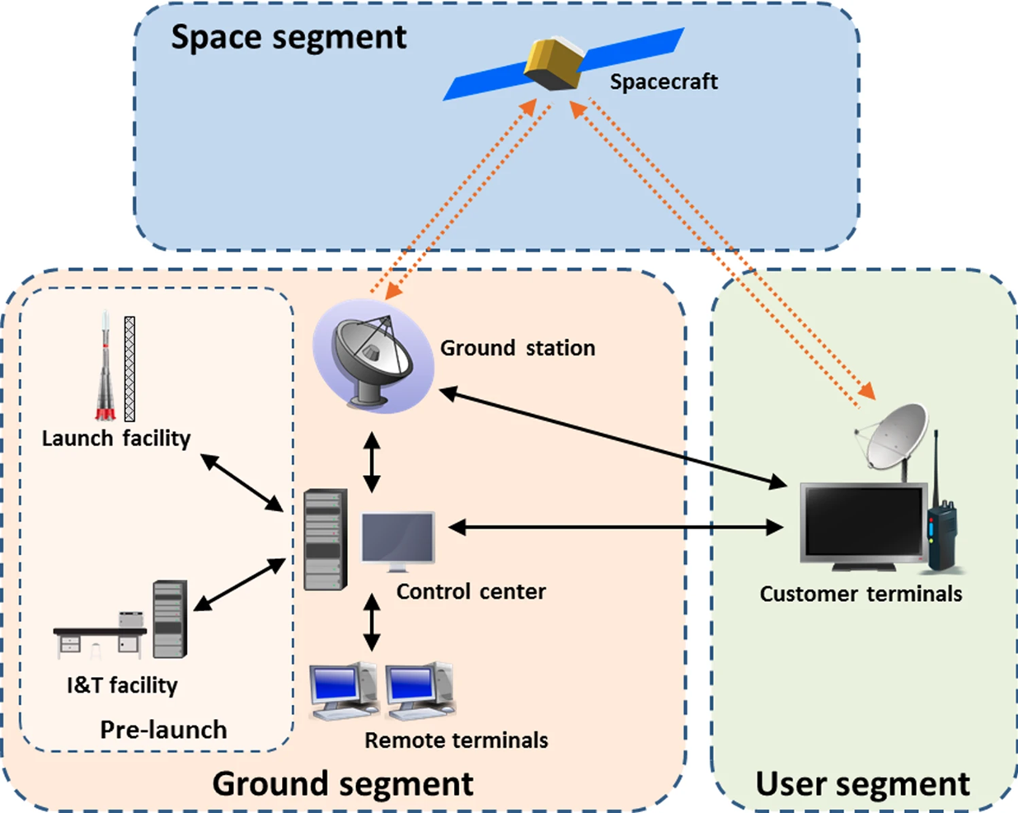
Threat Modelling 威脅建模
Attack Tree攻擊樹
Stride | DREAD
Cyber Killing Chain
MITRE ATTACK

Slide 3
Threat Modelling威脅建模: Stride | DREAD
https://zh.wikipedia.org/zh-tw/STRIDE
STRIDE是微軟的Praerit Garg和Loren Kohnfelder建立的威脅模型
目的是在找出電腦安全上的威脅。 是六種安全威脅分類英文的字首組成
STRIDE一開始是設計作為威脅模型分析程序的部份。STRIDE是威脅模型，讓分析者可以理解威脅系統的方式，並設法找出威脅。
STRIDE可以和目標系統的模型一起使用。分析過程會將程序、資料儲存、資料流及信任邊界（Trust boundaries）進行完整的拆解。
安全專家會用STRIDE來回答這個問題：「目前運作的系統中，哪些地方可能會有問題？」
每一個的威脅都會影響理想的系統屬性
Property屬性 | Threat | 定義 | 範例
驗證 Authentication | 欺騙 Spoofing | 冒充某物或他人。 | 冒充 billg、microsoft.com 或 ntdll.dll 中的任何一個
完整性 Integrity | 篡改_ Tampering | 修改數據或代碼 | 修改磁盤或 DVD 上的 DLL，或在數據包穿越 LAN 時修改數據包。
不可否認性 Non-repudiation | 否認_ Repudiation | 聲稱沒有採取任何行動。 | “我沒有發送那封電子郵件，” “我沒有修改那個文件，”
保密 Confidentiality | 信息披露 Information Disclosure | 向未經授權查看信息的人公開信息 | 允許某人閱讀 Windows 源代碼；將客戶列表發佈到網站。
可用性 Availability | 拒絕服務 Denial of Service | 拒絕或降低向用戶提供的服務 | 使 Windows 或網站崩潰、發送數據包並佔用數秒的 CPU 時間，或者將數據包路由到黑洞。
授權 Authorization | 特權提升 Elevation of Privilege | 未經適當授權就獲得能力 | 允許遠程互聯網用戶運行命令是一個典型的例子，但從受限用戶到管理員也是 EoP。
https://learn.microsoft.com/en-us/azure/security/develop/threat-modeling-tool-threats

Slide 4
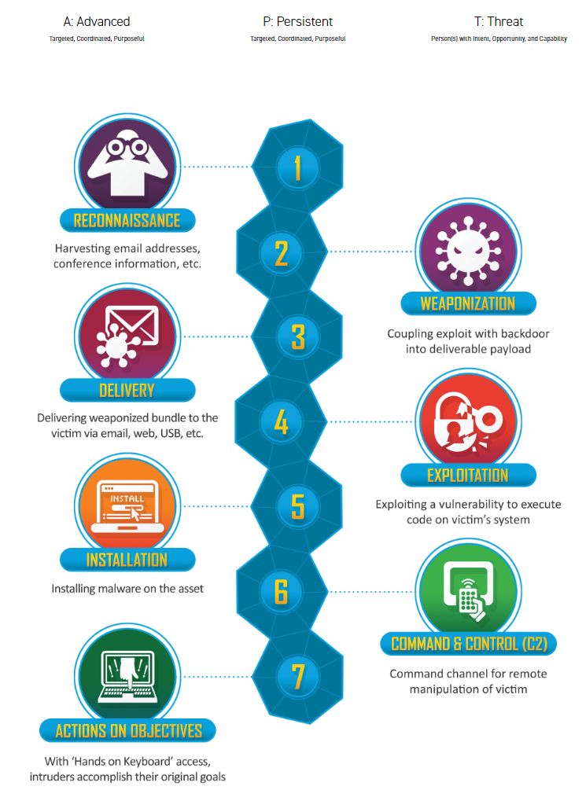
Cyber Killing Chain
https://www.lockheedmartin.com/en-us/capabilities/cyber/cyber-kill-chain.html
https://en.wikipedia.org/wiki/Kill_chain
網路攻擊鏈(Cyber Kill Chain) 7個環節
1.偵查 Reconnaissance | 攻擊者收集目標對象的資料，如電子郵件信箱、社群平台的資料，以找到可以下手的弱點；或是透過工具，掃描目標對象的網站、系統，得知使用的系統種類、版本
2.武裝 Weaponization | 攻擊者使用現成的開源工具或是自行開發專屬的惡意程式
3.遞送 Delivery | 攻擊者將攻擊武器送入目標的系統內，如透過釣魚信件裡的連結、夾帶木馬的盜版軟體、隨身碟
4.漏洞利用 Exploitation | 確保遞送的惡意軟體，藉由目標對象的系統漏洞，得以順利開啟，並使攻擊者獲得控制權
5.安裝 Installation | 攻擊者確保自身可以長期控制目標的系統內，以有足夠的時間進行後續環節
6.發令與控制 Command & Control | C2 攻擊者潛伏在目標的系統內，收集資料，探索環境，以便審慎規劃後續行動。
7.行動 Actions | 根據攻擊者的最終目標，採取行動，如破壞系統、竊取機密資料、勒索目標對象
https://teamt5.org/tw/posts/what-is-cyber-kill-chain/

Slide 5
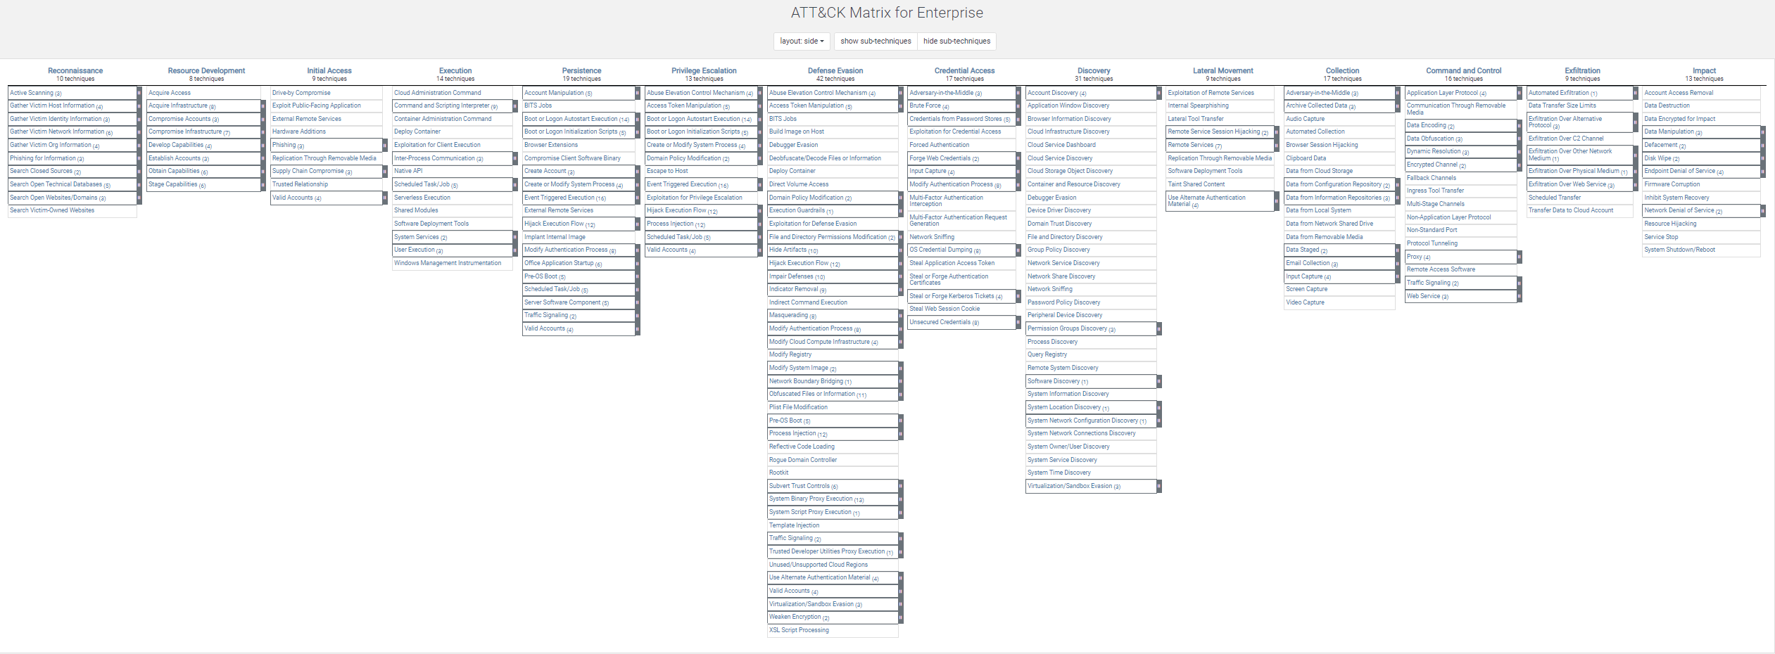
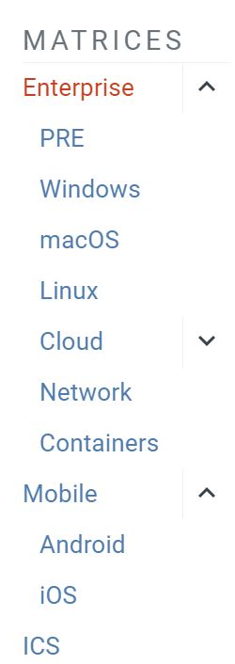

資安威脅趨勢 MiTRE Att@ck
https://attack.mitre.org/
https://go.crowdstrike.com/rs/281-OBQ-266/images/CrowdStrike2023GlobalThreatReport.pdf

Slide 6
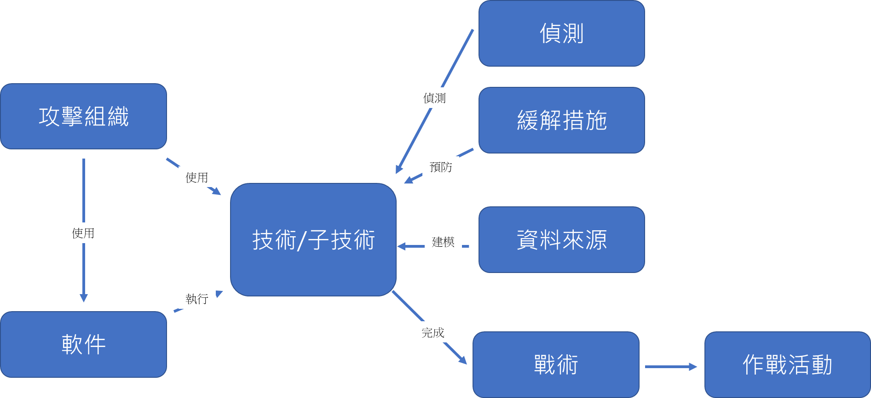

Slide 7
Tactics(戰術), Techniques, and Procedures (TTP) 用以描述威脅行動者的攻擊模式或特徵 一份有價值的威脅情資報告會提供詳盡的 TTPs 分析，協助使用者深入了解該次攻擊事件，從而採取正確的防禦措施
戰術(tactic) | 以宏觀層次描述描述網路攻擊
技巧(technique): | 比戰術的細節更多，提供完整的脈絡
程序(procedure): | 說明完整的攻擊過程，較技巧所提供的資訊更詳細
Tactics戰術(Techniques技巧數目)
1.偵察Reconnaissance(10)
2.資源開發Resource Development(8)
3.初步存取 Initial Access(9)
4.執行Execution(14)
5.持續性Persistence(19)
6.權限提升Privilege Escalation (13)
7.閃避掉防禦機制 Defense Evasion(42)
8.存取憑證 Credential Access(17)
9.發現Discovery(31)
10.橫向移動Lateral Movement(9)
11.收集Collection(17)
12.命令與控制Command and Control(16)
13.外洩Exfiltration(9)
14.衝擊Impact(13)
https://csrc.nist.gov/glossary/term/tactics_techniques_and_procedures
https://teamt5.org/tw/posts/what-are-tactics-techniques-and-procedures-ttps/
。

Slide 8
1.偵察Reconnaissance戰術的10大類型技術(Techniques)
1.主動掃描 Active Scanning(3)
2.收集受害者主機資料Gather Victim Host Information(4)
3.收集受害者身份資料 Gather Victim Identity Information(3)
4.收集受害者網路資料Gather Victim Network Information(6)
5.收集受害者組織資料 Gather Victim Org Information(4)
6.使用網路釣魚獲取資料 Phishing for Information(3)
7.搜索閉源Search Closed Sources(2)
8.搜索開放技術資料庫Search Open Technical Databases(5)
9.搜索開放的網站/網域 Search Open Websites/Domains(3)
10.搜索受害者擁有的網站Search Victim-Owned Websites

Slide 9
1.偵察Reconnaissance 戰術
4.收集受害者網路訊息 Gather Victim Network Information T1590 (6)技術
Adversaries(攻擊者)可能會收集有關受害者網路的信息，這些資訊可在瞄準期間使用。
有關網路的資訊可能包括各種詳細信息
包括管理資料（例如：IP 範圍、網域名稱等）
以及有關其拓撲和操作的細節。
Adversaries可以透過各種方式收集這些信息，
例如透過主動掃描或網路釣魚資訊進行直接收集操作。
有關網路的資訊也可能透過線上或其他可存取的資料集
（例如：搜尋開放技術資料庫）暴露給對手。
收集此資訊可能會揭示其他形式的偵察機會
（例如：主動掃描或搜尋開放網站/網域）、
建立營運資源（例如：取得基礎設施或破壞基礎設施）
或初始訪問（例如：信任關係）。
ID: T1590
Sub-techniques: T1590.001, T1590.002, T1590.003
T1590.004, T1590.005, T1590.006
Tactic: Reconnaissance
Platforms: PRE
Version: 1.0
Created: 02 October 2020
Last Modified: 15 April 2021
Sub-techniques (6)
ID | Name
T1590.001 | Domain Properties
T1590.002 | DNS
T1590.003 | Network Trust Dependencies
T1590.004 | Network Topology
T1590.005 | IP Addresses
T1590.006 | Network Security Appliances
Information about networks may also be exposed to
adversaries via online or other accessible data sets
(ex: Search Open Technical Databases).
Gathering this information may reveal opportunities for
other forms of reconnaissance
(ex: Active Scanning or Search Open Websites/Domains),
establishing operational resources
(ex: Acquire Infrastructure or Compromise Infrastructure),
and/or initial access (ex: Trusted Relationship).

Slide 10
1.偵察Reconnaissance 戰術|
4.收集受害者網路訊息 Gather Victim Network Information T1590 (6)技術
Sub-techniques (6)
ID | Name | Description
T1590.001 | Domain Properties 域屬性 | Adversaries may gather information about the victim's network domain(s) that can be used during targeting. Information about domains and their properties may include a variety of details, including what domain(s) the victim owns as well as administrative data (ex: name, registrar, etc.) and more directly actionable information such as contacts (email addresses and phone numbers), business addresses, and name servers. 攻擊者可能會收集有關受害者網路域的信息，這些資訊可在定位期間使用。有關網域及其屬性的資訊可能包括各種詳細信息，包括受害者擁有的網域名稱以及管理資料（例如：姓名、註冊商等）以及更直接的可操作信息，例如聯絡人（電子郵件地址和電話）號）、公司地址及名稱伺服器。

Slide 11
1.偵察Reconnaissance 戰術|
4.收集受害者網路訊息 Gather Victim Network Information T1590 (6)技術
Sub-techniques (6)
ID | Name | Description
T1590.002 | DNS 域名系統 | Adversaries may gather information about the victim's DNS that can be used during targeting. DNS information may include a variety of details, including registered name servers as well as records that outline addressing for a target’s subdomains, mail servers, and other hosts. DNS, MX, TXT, and SPF records may also reveal the use of third party cloud and SaaS providers, such as Office 365, G Suite, Salesforce, or Zendesk. 攻擊者可能會收集有關受害者 DNS 的信息，這些資訊可在定位期間使用。DNS 資訊可能包括各種詳細信息，包括註冊的名稱伺服器以及概述目標子網域、郵件伺服器和其他主機的尋址的記錄。DNS、MX、TXT 和 SPF 記錄也可能揭示第三方雲端和 SaaS 供應商的使用情況，例如 Office 365、G Suite、Salesforce 或 Zendesk。

Slide 12
1.偵察Reconnaissance 戰術|
4.收集受害者網路訊息 Gather Victim Network Information T1590 (6)技術
Sub-techniques (6)
ID | Name | Description
T1590.003 | Network Trust Dependencies 網路信任依賴 | Adversaries may gather information about the victim's network trust dependencies that can be used during targeting. Information about network trusts may include a variety of details, including second or third-party organizations/domains (ex: managed service providers, contractors, etc.) that have connected (and potentially elevated) network access. 攻擊者可能會收集有關受害者網路信任依賴項的信息，這些資訊可在定位期間使用。有關網路信任的資訊可能包括各種詳細信息，包括已連接（並可能提升）網路存取權限的第二或第三方組織/網域（例如：託管服務提供者、承包商等）。

Slide 13
1.偵察Reconnaissance 戰術|
4.收集受害者網路訊息 Gather Victim Network Information T1590 (6)技術
Sub-techniques (6)
ID | Name | Description
T1590.004 | Network Topology 網路拓撲結構 | Adversaries may gather information about the victim's network topology that can be used during targeting. Information about network topologies may include a variety of details, including the physical and/or logical arrangement of both external-facing and internal network environments. This information may also include specifics regarding network devices (gateways, routers, etc.) and other infrastructure. 攻擊者可能會收集有關受害者網路拓撲的信息，這些資訊可在定位期間使用。關於網路拓撲的資訊可以包括各種細節，包括面向外部和內部網路環境的實體和/或邏輯佈置。這些資訊還可能包括有關網路設備（網關、路由器等）和其他基礎設施的細節。

Slide 14
1.偵察Reconnaissance 戰術|
4.收集受害者網路訊息 Gather Victim Network Information T1590 (6)技術
Sub-techniques (6)
ID | Name | Description
T1590.005 | IP Addresses IP位址 | Adversaries may gather the victim's IP addresses that can be used during targeting. Public IP addresses may be allocated to organizations by block, or a range of sequential addresses. Information about assigned IP addresses may include a variety of details, such as which IP addresses are in use. IP addresses may also enable an adversary to derive other details about a victim, such as organizational size, physical location(s), Internet service provider, and or where/how their publicly-facing infrastructure is hosted. 攻擊者可能會收集受害者的 IP 位址，以便在定位期間使用。公用 IP 位址可以按區塊或一系列連續位址指派給組織。關於分配的IP位址的資訊可以包括各種細節，例如哪些IP位址正在使用。IP 位址還可能使攻擊者能夠獲取有關受害者的其他詳細信息，例如組織規模、物理位置、互聯網服務提供者以及/或其面向公眾的基礎設施的託管位置/方式。

Slide 15
1.偵察Reconnaissance 戰術|
4.收集受害者網路訊息 Gather Victim Network Information T1590 (6)技術
Sub-techniques (6)
ID | Name | Description
T1590.006 | Network Security Appliances 網路安全設備 | Adversaries may gather information about the victim's network security appliances that can be used during targeting. Information about network security appliances may include a variety of details, such as the existence and specifics of deployed firewalls, content filters, and proxies/bastion hosts. Adversaries may also target information about victim network-based intrusion detection systems (NIDS) or other appliances related to defensive cybersecurity operations. 攻擊者可能會收集有關受害者網路安全設備的信息，這些資訊可在瞄準期間使用。有關網路安全設備的資訊可能包括各種詳細信息，例如已部署的防火牆、內容過濾器和代理/堡壘主機的存在和細節。攻擊者也可能瞄準受害者基於網路的入侵偵測系統 (NIDS) 或與防禦性網路安全操作相關的其他設備的資訊。

Slide 16
1.偵察Reconnaissance 戰術|
4.收集受害者網路訊息 Gather Victim Network Information T1590 (6)技術
Procedure Examples 程式範例
ID | Name | Description
G0125 | HAFNIUM | HAFNIUM gathered the fully qualified domain names (FQDNs) for targeted Exchange servers in the victim's environment. HAFNIUM收集了受害者環境中目標 Exchange 伺服器的完全限定網域名稱 (FQDN)。
Mitigations 緩解措施
ID | Mitigation | Description
M1056 | Pre-compromise | This technique cannot be easily mitigated with preventive controls since it is based on behaviors performed outside of the scope of enterprise defenses and controls. 這種技術無法通過預防性控制輕鬆緩解，因為它基於在企業防禦和控制範圍之外執行的行為。 Efforts should focus on minimizing the amount and sensitivity of data available to external parties.應重點努力最大限度地減少外部各方可用數據的數量和敏感性。
Detection偵測
Much of this activity may have a very high occurrence and associated false positive rate, as well as potentially taking place outside the visibility of the target organization, making detection difficult for defenders.大多數此類活動的發生率和相關誤報率可能非常高，並且可能發生在目標組織的可見性之外，使防禦者難以檢測到。 Detection efforts may be focused on related stages of the adversary lifecycle, such as during Initial Access.檢測工作可能集中在對手生命週期的相關階段，例如初始訪問期間。

Slide 17
2.資源開發Resource Development 戰術的8大類型技術(Techniques)
1.取得存取權限 Acquire Access
2.取得基礎設施 Acquire Infrastructure (8)
3.洩漏帳戶 Compromise Accounts (3)
4.損害基礎設施 Compromise Infrastructure (7)
5.發展能力 Develop Capabilities (4)
6.建立帳戶 Establish Accounts (3)
7.獲得能力 Obtain Capabilities (6)
8.舞台能力 Stage Capabilities (6)

Slide 18
2.資源開發Resource Development 戰術
4.破壞基礎設施 Compromise Infrastructure T1584 (7)技術
Adversaries(攻擊者)可能會破壞可在定位過程中使用的第三方基礎設施。
基礎架構解決方案包括實體或雲端伺服器、
網域以及第三方 Web 和 DNS 服務。
Adversaries可能會破壞基礎設施並在對手生命週期的
其他階段使用它，而不是購買、租賃或租賃基礎設施。此外
Adversaries可能會破壞大量機器以形成他們可以利用的殭屍網路。
利用的基礎設施，攻擊者可以發動、啟動和執行操作。
受損的基礎設施可以幫助對手的操作融入正常的流量，
例如與高聲譽或受信任的站點的聯繫。
例如，對手可能會利用受損的基礎設施（也可能與數位證書結合）
來進一步融入並支援分階段的資訊收集和/或網路釣魚活動
此外， Adversaries還可能破壞基礎設施以支援Proxy。
ID: T1584
Sub-techniques: T1584.001, T1584.002, T1584.003
T1584.004, T1584.005, T1584.006 , T1584.007
Tactic: Resource Development
Platforms: PRE
Version: 1.3
Created: 01 October 2020
Last Modified: 12 April 2023
Sub-techniques (7)
ID | Name
T1584.001 | Domains
T1584.002 | DNS Server
T1584.003 | Virtual Private Server
T1584.004 | Server
T1584.005 | Botnet
T1584.006 | Web Services
T1584.007 | Serverless
Use of compromised infrastructure allows adversaries to stage,
launch, and execute operations.
Compromised infrastructure can help adversary
operations blend in with traffic that is seen as normal,
such as contact with high reputation or trusted sites.
For example, adversaries may leverage compromised infrastructure
(potentially also in conjunction with Digital Certificates)
to further blend in and support staged information gathering and/or
Phishing campaigns.
Additionally, adversaries may also compromise infrastructure to support Proxy.

Slide 19
2.資源開發Resource Development戰術| 4.損害基礎設施 Compromise Infrastructure T1584 (7)技術
Sub-techniques (7)
ID | Name | Description
T1584.001 | Domains 網域 | Adversaries may hijack domains and/or subdomains that can be used during targeting. Domain registration hijacking is the act of changing the registration of a domain name without the permission of the original registrant. Adversaries may gain access to an email account for the person listed as the owner of the domain. The adversary can then claim that they forgot their password in order to make changes to the domain registration. Other possibilities include social engineering a domain registration help desk to gain access to an account or taking advantage of renewal process gaps. 攻擊者可能會劫持可在定位過程中使用的網域和/或子網域。網域註冊劫持是指未經原註冊人許可，改變網域註冊的行為。攻擊者可能會存取被列為網域所有者的人員的電子郵件帳戶。然後，攻擊者可以聲稱他們忘記了密碼，以便更改網域註冊。其他可能性包括透過社交工程、網域註冊服務台來取得帳戶存取權限或利用續約流程的空白。

Slide 20
2.資源開發Resource Development戰術| 4.損害基礎設施 Compromise Infrastructure T1584 (7)技術
Sub-techniques (7)
ID | Name | Description
T1584.002 | DNS Server DNS伺服器 | Adversaries may compromise third-party DNS servers that can be used during targeting. During post-compromise activity, adversaries may utilize DNS traffic for various tasks, including for Command and Control (ex: Application Layer Protocol). Instead of setting up their own DNS servers, adversaries may compromise third-party DNS servers in support of operations. 攻擊者可能會破壞可在定位過程中使用的第三方 DNS 伺服器。在攻擊後活動期間，攻擊者可能會利用 DNS 流量執行各種任務，包括命令和控制（例如：應用層協定）。攻擊者可能會破壞第三方 DNS 伺服器來支援操作，而不是設定自己的 DNS 伺服器。

Slide 21
2.資源開發Resource Development戰術| 4.損害基礎設施 Compromise Infrastructure T1584 (7)技術
Sub-techniques (7)
ID | Name | Description
T1584.003 | Virtual Private Server 虛擬專用伺服器 | Adversaries may compromise third-party Virtual Private Servers (VPSs) that can be used during targeting. There exist a variety of cloud service providers that will sell virtual machines/containers as a service. Adversaries may compromise VPSs purchased by third-party entities. By compromising a VPS to use as infrastructure, adversaries can make it difficult to physically tie back operations to themselves. 攻擊者可能會破壞可在定位過程中使用的第三方虛擬專用伺服器 (VPS)。存在多種將虛擬機器/容器作為服務出售的雲端服務提供者。攻擊者可能會破壞第三方實體購買的 VPS。透過破壞用作基礎設施的 VPS，攻擊者可能很難將操作與自己進行物理聯繫。
T1584.004 | Server 伺服器 | Adversaries may compromise third-party servers that can be used during targeting. Use of servers allows an adversary to stage, launch, and execute an operation. During post-compromise activity, adversaries may utilize servers for various tasks, including for Command and Control. Instead of purchasing a Server or Virtual Private Server, adversaries may compromise third-party servers in support of operations. 攻擊者可能會破壞可在定位過程中使用的第三方伺服器。使用伺服器可以讓攻擊者發動、啟動和執行操作。在攻擊後活動期間，攻擊者可能會利用伺服器執行各種任務，包括命令和控制。攻擊者可能會破壞第三方伺服器來支援操作， 而不是購買伺服器或虛擬專用伺服器。

Slide 22
2.資源開發Resource Development戰術| 4.損害基礎設施 Compromise Infrastructure T1584 (7)技術
Sub-techniques (7)
ID | Name | Description
T1584.005 | Botnet 殭屍網路 | Adversaries may compromise numerous third-party systems to form a botnet that can be used during targeting. A botnet is a network of compromised systems that can be instructed to perform coordinated tasks. Instead of purchasing/renting a botnet from a booter/stresser service, adversaries may build their own botnet by compromising numerous third-party systems. Adversaries may also conduct a takeover of an existing botnet, such as redirecting bots to adversary-controlled C2 servers. With a botnet at their disposal, adversaries may perform follow-on activity such as large-scale Phishing or Distributed Denial of Service (DDoS). 攻擊者可能會破壞眾多第三方系統，形成可在目標定位期間使用的殭屍網路。殭屍網路是一個由受感染系統組成的網絡，可以指示這些系統執行協調任務。攻擊者可以透過破壞眾多第三方系統來建立自己的殭屍網絡，而不是從啟動器/壓力器服務購買/租用殭屍網路。對手也可能接管現有的殭屍網絡，例如將機器人重定向到對手控制的 C2 伺服器。有了殭屍網絡，攻擊者就可以執行後續活動，例如大規模網路釣魚或分散式阻斷服務 (DDoS)。

Slide 23
2.資源開發Resource Development戰術| 4.損害基礎設施 Compromise Infrastructure T1584 (7)技術
Sub-techniques (7)
ID | Name | Description
T1584.006 | Web Services 網頁服務 | Adversaries may compromise access to third-party web services that can be used during targeting. A variety of popular websites exist for legitimate users to register for web-based services, such as GitHub, Twitter, Dropbox, Google, SendGrid, etc. Adversaries may try to take ownership of a legitimate user's access to a web service and use that web service as infrastructure in support of cyber operations. Such web services can be abused during later stages of the adversary lifecycle, such as during Command and Control (Web Service), Exfiltration Over Web Service, or Phishing. Using common services, such as those offered by Google or Twitter, makes it easier for adversaries to hide in expected noise. By utilizing a web service, particularly when access is stolen from legitimate users, adversaries can make it difficult to physically tie back operations to them. Additionally, leveraging compromised web-based email services may allow adversaries to leverage the trust associated with legitimate domains. 攻擊者可能會破壞對可在定位過程中使用的第三方網路服務的存取。有許多流行網站供合法用戶註冊基於 Web 的服務，例如 GitHub、Twitter、Dropbox、Google、SendGrid 等。攻擊者可能會嘗試獲取合法用戶對 Web 服務的訪問權限並使用該 Web服務作為支援網路運營的基礎設施。此類 Web 服務可能會在攻擊者生命週期的後期階段被濫用，例如在命令和控制（Web 服務）、Web 服務滲透或網路釣魚期間。使用通用服務，例如Google或推特提供的服務，可以讓對手更容易隱藏在預期的噪音中。透過利用網路服務，特別是當合法用戶的存取權限被竊取時，攻擊者可能很難將操作與他們進行實體綁定。此外，利用受損的基於網路的電子郵件服務可能會讓對手利用與合法領域相關的信任。

Slide 24
2.資源開發Resource Development戰術| 4.損害基礎設施 Compromise Infrastructure T1584 (7)技術
Sub-techniques (7)
ID | Name | Description
T1584.007 | Serverless 無伺服器 | Adversaries may compromise serverless cloud infrastructure, such as Cloudflare Workers or AWS Lambda functions, that can be used during targeting. By utilizing serverless infrastructure, adversaries can make it more difficult to attribute infrastructure used during operations back to them. 攻擊者可能會破壞可在目標定位過程中使用的無伺服器雲端基礎設施，例如 Cloudflare Workers 或 AWS Lambda 函數。透過利用無伺服器基礎設施，對手可以更難以將操作期間使用的基礎設施歸因於他們。

Slide 25
2.資源開發Resource Development戰術| 4.損害基礎設施 Compromise Infrastructure T1584 (7)技術
Mitigations 緩解措施
ID | Mitigation | Description
M1056 | Pre-compromise | This technique cannot be easily mitigated with preventive controls since it is based on behaviors performed outside of the scope of enterprise defenses and controls. 這種技術無法通過預防性控制輕鬆緩解，因為它基於在企業防禦和控制範圍之外執行的行為。 Efforts should focus on minimizing the amount and sensitivity of data available to external parties.應重點努力最大限度地減少外部各方可用數據的數量和敏感性。

Slide 26
Detection偵測
ID | Data Source | Data Component | Detects
DS0038 | Domain Name網域 | Active DNS 網絡流量內容 | Monitor for queried domain name system (DNS) registry data that may compromise third-party infrastructure that can be used during targeting. Detection efforts may be focused on related stages of the adversary lifecycle, such as during Command and Control.監視查詢的網域名稱系統 (DNS) 註冊表數據，這些數據可能會損害可在定位過程中使用的第三方基礎設施。檢測工作可能集中在對手生命週期的相關階段，例如在命令和控制期間。
 |  | Domain Registration 域名註冊 | Consider monitoring for anomalous changes to domain registrant information and/or domain resolution information that may indicate the compromise of a domain. Efforts may need to be tailored to specific domains of interest as benign registration and resolution changes are a common occurrence on the internet.考慮監視域註冊者資訊和/或網域解析資訊的異常更改，這些更改可能表示網域受到威脅。由於良性註冊和解析度變更在網路上很常見，因此可能需要針對特定的興趣領域進行調整。
 |  | Passive DNS 被動DNS | Monitor for logged domain name system (DNS) data that may compromise third-party infrastructure that can be used during targeting. Detection efforts may be focused on related stages of the adversary lifecycle, such as during Command and Control.監控記錄的域名系統 (DNS) 數據，這些數據可能會損害可在定位過程中使用的第三方基礎設施。檢測工作可能集中在對手生命週期的相關階段，例如在命令和控制期間。
DS0035 | Internet Scan 網路掃描 | Response Content 回覆內容 | Once adversaries have provisioned compromised infrastructure (ex: a server for use in command and control), internet scans may help proactively discover compromised infrastructure. Consider looking for identifiable patterns such as services listening, certificates in use, SSL/TLS negotiation features, or other response artifacts associated with adversary C2 software一旦對手提供了受損的基礎設施（例如：用於命令和控制的伺服器），網路掃描可能有助於主動發現受損的基礎設施。考慮尋找可辨識的模式，例如服務偵聽、使用的憑證、SSL/TLS 協商功能或與對手 C2 軟體相關的其他回應工件
 |  | Response Metadata 響應元數據 | Monitor for contextual data about an Internet-facing resource gathered from a scan, such as running services or ports that may compromise third-party infrastructure that can be used during targeting. Detection efforts may be focused on related stages of the adversary lifecycle, such as during Command and Control.監視從掃描中收集的有關面向 Internet 的資源的上下文數據，例如可能會損害在定位過程中使用的第三方基礎設施的正在運行的服務或連接埠。檢測工作可能集中在對手生命週期的相關階段，例如在命令和控制期間。

Slide 27
3.初步存取Initial Access 戰術的9大類型技術(Techniques)
1.路過式妥協 Drive-by Compromise
2.利用面向公眾的應用程式 Exploit Public-Facing Application
3.外部遠端服務 External Remote Services
4.硬體添加 Hardware Additions
5.網路釣魚 Phishing (3)
6.透過可移動介質複製 Replication Through Removable Media
7.供應鏈妥協 Supply Chain Compromise (3)
8.值得信賴的關係 Trusted Relationship
9.有效帳戶 Valid Accounts (4)

Slide 28
3.初步存取Initial Access 戰術| 5.網路釣魚 Phishing T1566 (3)技術
Adversaries(攻擊者)可能會發送網路釣魚訊息以獲取受害者係統的存取權限。
所有形式的網路釣魚都是透過電子方式進行的社會工程。
網路釣魚可以是有針對性的，稱為魚叉式網路釣魚。
在魚叉式網路釣魚中，特定的個人、公司或產業將成為
Adversaries的目標。
更一般地說，對手可以進行非針對性的網路釣魚
例如大規模惡意軟體垃圾郵件活動。
Adversaries可能會向受害者發送包含惡意附件或連結
的電子郵件，通常是為了在受害者係統上執行惡意程式碼。
網路釣魚也可能透過社群媒體平台等第三方服務進行。
網路釣魚也可能涉及社會工程技術，例如冒充可信任來源
以及規避技術，例如從被濫用來發送訊息的受損帳戶中刪除或操縱
電子郵件或元資料/標頭（例如，電子郵件隱藏規則）。
實現此目的的另一種方法是偽造或欺騙發送者的身份，
可用於欺騙笨蛋人類的接收者以及自動安全工具。
受害者也可能收到網路釣魚訊息，指示他們撥打電話號碼，在該電話號碼中他們被引導訪問惡意 URL、下載惡意軟體在其電腦上安裝對手可存取的遠端管理工具（即使用者執行）
Victims may also receive phishing messages that instruct them to call a phone number where they are directed to visit a malicious URL, download malware , or install adversary-accessible remote management tools onto their computer (i.e., User Execution).
ID: T1595
Sub-techniques: T1566.001, T1566.002, T1566.003, T1566.004
Tactic: Initial Access
Platforms: Google Workspace, Linux, Office 365, SaaS, Windows, macOS
Version: 2.3
Created: 02 March 2020
Last Modified: 14 April 2023
Sub-techniques (3)
ID | Name
T1566.001 | Spearphishing Attachment
T1566.002 | Spearphishing Link
T1566.003 | Spearphishing via Service
T1566.004 | Spearphishing Voice

Slide 29
3.初步存取Initial Access 戰術| 5.網路釣魚 Phishing T1566 (3)技術
Sub-techniques (3)
ID | Name | Description
T1566.001 | Spearphishing Attachment 魚叉式網路釣魚配件 | Adversaries may send spearphishing emails with a malicious attachment in an attempt to gain access to victim systems. Spearphishing attachment is a specific variant of spearphishing. Spearphishing attachment is different from other forms of spearphishing in that it employs the use of malware attached to an email. All forms of spearphishing are electronically delivered social engineering targeted at a specific individual, company, or industry. In this scenario, adversaries attach a file to the spearphishing email and usually rely upon User Execution to gain execution. Spearphishing may also involve social engineering techniques, such as posing as a trusted source. 攻擊者可能會發送帶有惡意附件的魚叉式網路釣魚電子郵件，試圖存取受害者係統。魚叉式網路釣魚配件是魚叉式網路釣魚的一種特定變體。魚叉式網路釣魚配件與其他形式的魚叉式網路釣魚不同，它使用附加到電子郵件的惡意軟體。所有形式的魚叉式網路釣魚都是針對特定個人、公司或產業以電子方式進行的社會工程。在這種情況下，攻擊者將檔案附加到魚叉式網路釣魚電子郵件中，並且通常依靠使用者執行來獲得執行。魚叉式網路釣魚也可能涉及社會工程技術，例如冒充可信來源。

Slide 30
3.初步存取Initial Access 戰術| 5.網路釣魚 Phishing T1566 (3)技術
Sub-techniques (3)
ID | Name | Description
T1566.002 | Spearphishing Link 魚叉式釣魚鏈接 | Adversaries may send spearphishing emails with a malicious link in an attempt to gain access to victim systems. Spearphishing with a link is a specific variant of spearphishing. It is different from other forms of spearphishing in that it employs the use of links to download malware contained in email, instead of attaching malicious files to the email itself, to avoid defenses that may inspect email attachments. Spearphishing may also involve social engineering techniques, such as posing as a trusted source. 攻擊者可能會發送帶有惡意連結的魚叉式網路釣魚電子郵件，試圖存取受害者係統。帶有連結的魚叉式網路釣魚是魚叉式網路釣魚的一種特定變體。它與其他形式的魚叉式網路釣魚不同，它使用連結下載電子郵件中包含的惡意軟體，而不是將惡意檔案附加到電子郵件本身，以避免可能檢查電子郵件附件的防禦。魚叉式網路釣魚也可能涉及社會工程技術，例如冒充可信來源。

Slide 31
3.初步存取Initial Access 戰術| 5.網路釣魚 Phishing T1566 (3)技術
Sub-techniques (3)
ID | Name | Description
T1566.003 | Spearphishing via Service 透過服務進行魚叉式網路釣魚 | Adversaries may send spearphishing messages via third-party services in an attempt to gain access to victim systems. Spearphishing via service is a specific variant of spearphishing. It is different from other forms of spearphishing in that it employs the use of third party services rather than directly via enterprise email channels. 攻擊者可能會透過第三方服務發送魚叉式網路釣魚訊息，試圖存取受害者係統。透過服務進行魚叉式網路釣魚是魚叉式網路釣魚的一種特定變體。它與其他形式的魚叉式網路釣魚不同，它使用第三方服務，而不是直接透過企業電子郵件管道。

Slide 32
3.初步存取Initial Access 戰術| 5.網路釣魚 Phishing T1566 (3)技術
Sub-techniques (3)
ID | Name | Description
T1566.004 | Spearphishing Voice 魚叉式網路釣魚聲音 | Adversaries may use voice communications to ultimately gain access to victim systems. Spearphishing voice is a specific variant of spearphishing. It is different from other forms of spearphishing in that is employs the use of manipulating a user into providing access to systems through a phone call or other forms of voice communications. Spearphishing frequently involves social engineering techniques, such as posing as a trusted source (ex: Impersonation) and/or creating a sense of urgency or alarm for the recipient. 對手可能會使用語音通訊來最終存取受害者係統。魚叉式網路釣魚語音是魚叉式網路釣魚的一種特定變體。它與其他形式的魚叉式網路釣魚不同，它利用操縱用戶透過電話或其他形式的語音通訊來提供對系統的存取。魚叉式網路釣魚經常涉及社會工程技術，例如冒充可信來源（例如：假冒）和/或為收件者製造緊迫感或警報。

Slide 33
3.初步存取Initial Access 戰術| 5.網路釣魚 Phishing T1566 (3)技術
Procedure Examples 程式範例
ID | Name | Description
G0001 | Axiom | Axiom has used spear phishing to initially compromise victims. Axiom最初使用魚叉式網路釣魚來危害受害者。
G0115 | GOLD SOUTHFIELD | GOLD SOUTHFIELD has conducted malicious spam (malspam) campaigns to gain access to victim's machines. GOLD SOUTHFIELD進行了惡意垃圾郵件 (malspam) 活動，以取得受害者電腦的存取權限。
S0009 | Hikit | Hikit has been spread through spear phishing. Hikit是透過魚叉式網路釣魚傳播的。
S1073 | Royal | Royal has been spread through the use of phishing campaigns including "call back phishing" where victims are lured into calling a number provided through email. Royal是透過網路釣魚活動傳播的，其中包括“回撥網路釣魚”，誘使受害者撥打透過電子郵件提供的號碼。

Slide 34
3.初步存取Initial Access 戰術| 5.網路釣魚 Phishing T1566 (3)技術
Mitigations 緩解措施
ID | Mitigation | Description
M1049 | Antivirus/Antimalware | Anti-virus can automatically quarantine suspicious files. 防毒軟體可以自動隔離可疑檔案。
M1031 | Network Intrusion Prevention | Network intrusion prevention systems and systems designed to scan and remove malicious email attachments or links can be used to block activity. 網路入侵防禦系統和旨在掃描和刪除惡意電子郵件附件或連結的系統可用於阻止活動。
M1021 | Restrict Web-Based Content | Determine if certain websites or attachment types (ex: .scr, .exe, .pif, .cpl, etc.) that can be used for phishing are necessary for business operations and consider blocking access if activity cannot be monitored well or if it poses a significant risk. 確定可用於網路釣魚的某些網站或附件類型（例如：.scr、.exe、.pif、.cpl 等）對於業務運作是否是必需的，如果無法很好地監控活動或構成威脅，請考慮阻止訪問一個重大風險。
M1054 | Software Configuration | Use anti-spoofing and email authentication mechanisms to filter messages based on validity checks of the sender domain (using SPF) and integrity of messages (using DKIM). Enabling these mechanisms within an organization (through policies such as DMARC) may enable recipients (intra-org and cross domain) to perform similar message filtering and validation. 使用反欺騙和電子郵件驗證機制，根據寄件者網域的有效性檢查（使用 SPF）和郵件完整性（使用 DKIM）來過濾郵件。在組織內啟用這些機制（透過 DMARC 等策略）可以使收件者（組織內和跨網域）執行類似的郵件過濾和驗證。
M1017 | User Training | Users can be trained to identify social engineering techniques and phishing emails. 可以培訓使用者識別社會工程技術和網路釣魚電子郵件。

Slide 35
Detection偵測
ID | Data Source | Data Component | Detects
DS0015 | Application Log | Application Log Content 應用程式日誌內容 | Monitor for third-party application logging, messaging, and/or other artifacts that may send phishing messages to gain access to victim systems. Filtering based on DKIM+SPF or header analysis can help detect when the email sender is spoofed.URL inspection within email (including expanding shortened links) can help detect links leading to known malicious sites. Detonation chambers can be used to detect these links and either automatically go to these sites to determine if they're potentially malicious, or wait and capture the content if a user visits the link.監視可能發送網路釣魚訊息以存取受害系統的第三方應用程式日誌記錄、訊息傳遞和/或其他工件。基於 DKIM+SPF 或標頭分析的過濾可以幫助偵測電子郵件寄件者何時被欺騙。電子郵件中的 URL 檢查（包括擴充縮短的連結）可以協助偵測通往已知惡意網站的連結。爆炸室可用於檢測這些鏈接，並自動訪問這些網站以確定它們是否可能是惡意的，或者在用戶訪問該鏈接時等待並捕獲內容。
DS0022 | File | File Creation 文件創建 | Monitor for newly constructed files from a phishing messages to gain access to victim systems. 監視網路釣魚訊息中新建的文件，以取得受害者係統的存取權限。
DS0029 | Network Traffic | Network Traffic Content 網路流量內容 | Monitor and analyze SSL/TLS traffic patterns and packet inspection associated to protocol(s) that do not follow the expected protocol standards and traffic flows (e.g. extraneous packets that do not belong to established flows, gratuitous or anomalous traffic patterns, anomalous syntax, or structure). Consider correlation with process monitoring and command line to detect anomalous processes execution and command line arguments associated to traffic patterns (e.g. monitor anomalies in use of files that do not normally initiate connections for respective protocol(s)). Filtering based on DKIM+SPF or header analysis can help detect when the email sender is spoofed.監控和分析與不遵循預期協定標準和流量的協定相關的 SSL/TLS 流量模式和資料包檢查（例如，不屬於已建立流的無關資料包、無償或異常流量模式、異常語法或結構）。考慮與進程監控和命令列的相關性，以偵測與流量模式關聯的異常進程執行和命令列參數（例如，監控通常不會為相應協定啟動連線的檔案使用中的異常情況）。基於 DKIM+SPF 或標頭分析的過濾可以幫助偵測電子郵件寄件者何時被欺騙。
 |  | Network Traffic Flow 網路流量 | Monitor network data for uncommon data flows. Processes utilizing the network that do not normally have network communication or have never been seen before are suspicious. 監視網路資料中不常見的資料流。使用通常沒有網路通訊或以前從未見過的網路的進程是可疑的。

Slide 36
4.執行Execution 戰術的14大類型技術(Techniques)
1.雲端管理命令 Cloud Administration Command
2.命令和腳本解釋器 Command and Scripting Interpreter (9)
3.貨櫃管理指揮部 Container Administration Command
4.部署容器 Deploy Container
5.利用客戶端執行 Exploitation for Client Execution
6.進程間通訊 Inter-Process Communication (3)
7.原生API Native API
8.計劃任務/作業 Scheduled Task/Job (5)
9.無伺服器執行 Serverless Execution
10.共享模組 Shared Modules

Slide 37
4.執行Execution 戰術的14大類型技術(Techniques)
11.軟體部署工具 Software Deployment Tools
12.系統服務 System Services (2)
13.使用者執行 User Execution (3)
14. Windows 管理工具 Windows Management Instrumentation

Slide 38
4.執行Execution 戰術| 8.計劃任務/作業 Scheduled Task/Job T1053 (5)技術
ID: T1053
Sub-techniques: T1053.002, T1053.003, T1053.005, T1053.006, T1053.007
Tactic: Execution, Persistence, Privilege Escalation
Platforms: Containers, Linux, Windows, macOS
Permissions Required: Administrator, SYSTEM, User
Effective Permissions: Administrator, SYSTEM, User
Supports Remote: Yes
Contributors: Alain Homewood, Insomnia Security; Andrew Northern, @ex_raritas; Bryan Campbell, @bry_campbell; Leo Loobeek, @leoloobeek; Prashant Verma, Paladion; Selena Larson, @selenalarson; Travis Smith, Tripwire; Zachary Abzug, @ZackDoesML
Version: 2.2
Created: 31 May 2017
Last Modified: 30 March 2023
Adversaries(攻擊者)可能會濫用任務排程功能來促進惡意程式碼的初始或重複執行。所有主要作業系統中都存在實用程序，用於安排程序或腳本在指定的日期和時間執行。如果滿足正確的身份驗證（例如：Windows 環境中的 RPC 以及檔案和印表機共用），也可以在遠端系統上安排任務。在遠端系統上安排任務通常可能需要成為遠端系統上的管理員或其他特權群組的成員。
Adversaries可以使用任務調度在系統啟動時或按計畫持久性地執行程式。這些機制也可能被濫用在指定帳戶（例如具有提升權限/特權的帳戶）的上下文中執行程序。與系統二進位代理執行類似，攻擊者也濫用任務調度來潛在地掩蓋可信任系統進程下的一次性執行。
Adversaries may use task scheduling to execute programs at system startup or on a scheduled basis for persistence. These mechanisms can also be abused to run a process under the context of a specified account (such as one with elevated permissions/privileges). Similar to System Binary Proxy Execution, adversaries have also abused task scheduling to potentially mask one-time execution under a trusted system process.
Sub-techniques (5)
ID | Name
T1053.002 | At
T1053.003 | Cron
T1053.005 | Scheduled Task
T1053.006 | Systemd Timers
T1053.007 | Container Orchestration Job

Slide 39
4.執行Execution 戰術| 8.計劃任務/作業 Scheduled Task/Job T1053 (5)技術
Sub-techniques (5)
ID | Name | Description
T1053.002 | At 在 | Adversaries may abuse the at utility to perform task scheduling for initial or recurring execution of malicious code. The at utility exists as an executable within Windows, Linux, and macOS for scheduling tasks at a specified time and date. Although deprecated in favor of Scheduled Task's schtasks in Windows environments, using at requires that the Task Scheduler service be running, and the user to be logged on as a member of the local Administrators group. 攻擊者可能會濫用at實用程式來執行任務調度，以初始或重複執行惡意程式碼。at實用程式以 Windows、Linux 和 macOS 中的可執行檔案存在，用於在指定時間和日期安排任務。儘管在 Windows 環境中已棄用Scheduled Task的schtasks ，但使用at要求任務排程器服務正在執行，且使用者以本機管理員群組成員的身分登入。

Slide 40
4.執行Execution 戰術| 8.計劃任務/作業 Scheduled Task/Job T1053 (5)技術
Sub-techniques (5)
ID | Name | Description
T1053.003 | Cron 克朗 | Adversaries may abuse the cron utility to perform task scheduling for initial or recurring execution of malicious code. The cron utility is a time-based job scheduler for Unix-like operating systems. The crontab file contains the schedule of cron entries to be run and the specified times for execution. Any crontab files are stored in operating system-specific file paths. 攻擊者可能會濫用該cron實用程式來執行任務調度，以初始或重複執行惡意程式碼。該cron實用程式是用於類別 Unix 作業系統的基於時間的作業排程器。該 crontab檔案包含要執行的 cron 條目的計畫以及指定的執行時間。所有crontab檔案都儲存在作業系統特定的檔案路徑中。

Slide 41
4.執行Execution 戰術| 8.計劃任務/作業 Scheduled Task/Job T1053 (5)技術
Sub-techniques (5)
ID | Name | Description
T1053.005 | Scheduled Task 計劃任務 | Adversaries may abuse the Windows Task Scheduler to perform task scheduling for initial or recurring execution of malicious code. There are multiple ways to access the Task Scheduler in Windows. The schtasks utility can be run directly on the command line, or the Task Scheduler can be opened through the GUI within the Administrator Tools section of the Control Panel. In some cases, adversaries have used a .NET wrapper for the Windows Task Scheduler, and alternatively, adversaries have used the Windows netapi32 library to create a scheduled task. 攻擊者可能會濫用 Windows 任務計劃程式來執行任務規劃，以初始或重複執行惡意程式碼。有多種方法可以存取 Windows 中的任務計劃程式。schtasks實用程式可以直接在命令列上執行，也可以透過控制面板的管理員工具部分中的 GUI 開啟任務排程器。在某些情況下，攻擊者使用 Windows 工作排程器的 .NET 包裝器，或使用 Windows netapi32 程式庫來建立排程任務。

Slide 42
4.執行Execution 戰術| 8.計劃任務/作業 Scheduled Task/Job T1053 (5)技術
Sub-techniques (5)
ID | Name | Description
T1053.006 | Systemd Timers 系統定時器 | Adversaries may abuse systemd timers to perform task scheduling for initial or recurring execution of malicious code. Systemd timers are unit files with file extension .timer that control services. Timers can be set to run on a calendar event or after a time span relative to a starting point. They can be used as an alternative to Cron in Linux environments. Systemd timers may be activated remotely via the systemctl command line utility, which operates over SSH. 攻擊者可能會濫用 systemd 計時器來執行任務調度，以初始或重複執行惡意程式碼。Systemd 計時器是具有.timer控制服務的檔案副檔名的單元檔案。計時器可以設定在日曆事件上運行或在相對於起始點的時間跨度之後運行。它們可以用作Linux 環境中Cron的替代方案。Systemd 計時器可以透過命令列實用程式遠端激活systemctl，該實用程式透過SSH運作。

Slide 43
4.執行Execution 戰術| 8.計劃任務/作業 Scheduled Task/Job T1053 (5)技術
Sub-techniques (5)
ID | Name | Description
T1053.007 | Container Orchestration Job 容器編排作業 | Adversaries may abuse task scheduling functionality provided by container orchestration tools such as Kubernetes to schedule deployment of containers configured to execute malicious code. Container orchestration jobs run these automated tasks at a specific date and time, similar to cron jobs on a Linux system. Deployments of this type can also be configured to maintain a quantity of containers over time, automating the process of maintaining persistence within a cluster. 攻擊者可能會濫用 Kubernetes 等容器編排工具提供的任務排程功能來調度配置為執行惡意程式碼的容器的部署。容器編排作業在特定日期和時間執行這些自動化任務，類似於 Linux 系統上的 cron 作業。這種類型的部署還可以配置為隨著時間的推移維護一定數量的容器，從而自動化維護叢集內持久性的過程。

Slide 44
4.執行Execution 戰術| 8.計劃任務/作業 Scheduled Task/Job T1053 (5)技術
Procedure Examples 程式範例
ID | Name | Description
S1052 | DEADEYE | DEADEYE has used the scheduled tasks \Microsoft\Windows\PLA\Server Manager Performance Monitor, \Microsoft\Windows\Ras\ManagerMobility, \Microsoft\Windows\WDI\SrvSetupResults, and \Microsoft\Windows\WDI\USOShared to establish persistence. DEADEYE使用計劃任務來建立持久性。。
G1006 | Earth Lusca | Earth Lusca used the command schtasks /Create /SC ONLOgon /TN WindowsUpdateCheck /TR "[file path]" /ru system for persistence. Earth Lusca使用這個命令是為了續編。
S0447 | Lokibot | Lokibot's second stage DLL has set a timer using "timeSetEvent" to schedule its next execution. Lokibot的第二階段 DLL 使用「timeSetEvent」設定了一個計時器來安排其下一次執行。
S0125 | Remsec | Remsec schedules the execution one of its modules by creating a new scheduler task. Remsec透過建立新的調度程序任務來調度其模組之一的執行。
S1034 | StrifeWater | StrifeWater has create a scheduled task named Mozilla\Firefox Default Browser Agent 409046Z0FF4A39CB for persistence. StrifeWater創建了一個名為持久性的計劃任務。

Slide 45
Mitigations 緩解措施
ID | Mitigation | Description
M1047 | Audit | Toolkits like the PowerSploit framework contain PowerUp modules that can be used to explore systems for permission weaknesses in scheduled tasks that could be used to escalate privileges. PowerSploit 框架等工具包包含 PowerUp 模組，可用於探索系統排程任務中的權限弱點，可用於提升權限。
M1028 | Operating System Configuration | Configure settings for scheduled tasks to force tasks to run under the context of the authenticated account instead of allowing them to run as SYSTEM. The associated Registry key is located at HKLM\SYSTEM\CurrentControlSet\Control\Lsa\SubmitControl. The setting can be configured through GPO: Computer Configuration > [Policies] > Windows Settings > Security Settings > Local Policies > Security Options: Domain Controller: Allow server operators to schedule tasks, set to disabled. 配置計劃任務的設定以強制任務在經過身份驗證的帳戶的上下文中運行，而不是允許它們作為 SYSTEM 運行。關聯的註冊表項位於HKLM\SYSTEM\CurrentControlSet\Control\Lsa\SubmitControl。可透過 GPO 設定此設定：電腦設定 > [策略] > Windows 設定 > 安全性設定 > 本機原則 > 安全性選項： 網域控制站：允許伺服器操作員排程任務，設定為停用。

Slide 46
Mitigations 緩解措施
ID | Mitigation | Description
M1026 | Privileged Account Management | Configure the Increase Scheduling Priority option to only allow the Administrators group the rights to schedule a priority process. This can be can be configured through GPO: Computer Configuration > [Policies] > Windows Settings > Security Settings > Local Policies > User Rights Assignment: Increase scheduling priority. 配置「增加排程優先權」選項以僅允許管理員群組調度優先權進程的權限。這可以透過 GPO 進行設定：電腦設定 > [策略] > Windows 設定 > 安全性設定 > 本機原則 > 使用者權限指派：增加計畫優先權。
M1018 | User Account Management | Limit privileges of user accounts and remediate Privilege Escalation vectors so only authorized administrators can create scheduled tasks on remote systems. 限制使用者帳戶的權限並修復權限升級向量，以便只有授權管理員才能在遠端系統上建立排程任務。

Slide 47
Detection偵測
ID | Data Source | Data Component | Detects
DS0017 | Command | Command Execution 命令執行 | Monitor executed commands and arguments that may abuse task scheduling functionality to facilitate initial or recurring execution of malicious code. 監視可能濫用任務調度功能以促進惡意程式碼的初始或重複執行的已執行命令和參數。
DS0032 | Container | Container Creation 容器創建 | Monitor for newly constructed containers that may abuse task scheduling functionality to facilitate initial or recurring execution of malicious code. 監視可能濫用任務調度功能以促進惡意程式碼的初始或重複執行的新容器。
DS0022 | File | File Creation文件創建 | Monitor newly constructed files that may abuse task scheduling functionality to facilitate initial or recurring execution of malicious code. 監視可能濫用任務調度功能以促進惡意程式碼的初始或重複執行的新檔案。
 |  | File Modification 文件修改 | Monitor for changes made to files that may abuse task scheduling functionality to facilitate initial or recurring execution of malicious code. 監視對檔案所做的更改，這些更改可能會濫用任務規劃功能以促進惡意程式碼的初始或重複執行。

Slide 48
Detection偵測
ID | Data Source | Data Component | Detects
DS0009 | Process | Process Creation 流程創建 | Monitor for newly executed processes that may abuse task scheduling functionality to facilitate initial or recurring execution of malicious code. 監視可能濫用任務調度功能以促進惡意程式碼的初始或重複執行的新執行的進程。
DS0003 | Scheduled Job | Scheduled Job Creation 計劃創造就業機會 | Monitor newly constructed scheduled jobs that may abuse task scheduling functionality to facilitate initial or recurring execution of malicious code. 監視可能濫用任務排程功能以促進惡意程式碼的初始或重複執行的新建置的排程作業。

Slide 49
5.持續Persistence 戰術的20大類型技術(Techniques)
1.帳戶操縱 (5) Account Manipulation
2.處理傳輸工作 BITS Jobs
3.引導或登入自動啟動執行 (14) Boot or Logon Autostart Execution
4.啟動或登入初始化腳本 (5) Boot or Logon Initialization Scripts
5.瀏覽器擴充 Browser Extensions
6.洩漏客戶端軟體二進位文件 Compromise Client Software Binary
7.建立帳戶 (3) Create Account
8.建立或修改系統進程 (4) Create or Modify System Process
9.事件觸發執行 (16) Event Triggered Execution
10.外部遠端服務 External Remote Services

Slide 50
5.持續Persistence 戰術的20大類型技術(Techniques)
11.劫持執行流程 (13) Hijack Execution Flow
12.植體內部圖像 Implant Internal Image
13.修改認證流程(8) Modify Authentication Process
14.辦公室應用程式啟動(6) Office Application Startup
15.電源設定Power Settings
16.預先作業系統啟動(5) Pre-OS Boot
17.計劃任務/作業(5) Scheduled Task/Job
18.伺服器軟體元件(5) Server Software Component
19.貿易訊號(2) Traffic Signaling
20.有效帳戶(4) Valid Accounts

Slide 51
5.持續Persistence 戰術| 7.建立帳戶 Create Account (3)技術
Sub-techniques (3)
ID | Name | Description
T1136.001 | Local Account 本地帳戶 | Adversaries may create a local account to maintain access to victim systems. Local accounts are those configured by an organization for use by users, remote support, services, or for administration on a single system or service. 攻擊者可能會建立本機帳戶來維護對受害者係統的存取。本機帳戶是由組織配置供使用者、遠端支援、服務使用或在單一系統或服務上進行管理的帳戶。

Slide 52
5.持續Persistence 戰術| 7.建立帳戶 Create Account (3)技術
Sub-techniques (3)
ID | Name | Description
T1136.002 | Domain Account 網域帳戶 | Adversaries may create a domain account to maintain access to victim systems. Domain accounts are those managed by Active Directory Domain Services where access and permissions are configured across systems and services that are part of that domain. Domain accounts can cover user, administrator, and service accounts. With a sufficient level of access, the net user /add /domain command can be used to create a domain account. 攻擊者可能會建立網域帳戶來維護對受害者係統的存取。網域帳戶是由 Active Directory 網域服務管理的帳戶，其中存取和權限是跨屬於該網域的系統和服務配置的。網域帳戶可以涵蓋使用者、管理員和服務帳戶。具有足夠的存取等級後，net user /add /domain可以使用該命令建立網域帳戶。
T1136.003 | Cloud Account 雲端帳戶 | Adversaries may create a cloud account to maintain access to victim systems. With a sufficient level of access, such accounts may be used to establish secondary credentialed access that does not require persistent remote access tools to be deployed on the system. 攻擊者可能會建立一個雲端帳戶來維持對受害者係統的存取。透過足夠的存取級別，此類帳戶可用於建立不需要在系統上部署持久遠端存取工具的輔助憑證存取。

Slide 53
5.持續Persistence 戰術| 7.建立帳戶 Create Account (3)技術
Adversaries(攻擊者)可能會建立一個帳戶來維持對受害者係統的存取。透過足夠的存取級別，建立此類帳戶可用於建立不需要在系統上部署持久遠端存取工具的輔助憑證存取。
帳戶可以在本機系統或網域或雲端租用戶內建立。在雲端環境中， Adversaries可能會建立只能存取特定服務的帳戶，這可以減少偵測到的機會。
Adversaries may create an account to maintain access to victim systems. With a sufficient level of access, creating such accounts may be used to establish secondary credentialed access that do not require persistent remote access tools to be deployed on the system.
Accounts may be created on the local system or within a domain or cloud tenant. In cloud environments, adversaries may create accounts that only have access to specific services, which can reduce the chance of detection.
ID: T1136
Sub-techniques : T1136.001, T1136.002, T1136.003
Tactic : Persistence
Platforms: Azure AD, Google Workspace, IaaS, Linux, Network, Office 365, Windows, macOS
Contributors : Austin Clark, @c2defense; Microsoft Threat Intelligence Center (MSTIC); Praetorian
Version : 2.3
Created : 14 December 2017
Last Modified : 12 April 2023
Sub-techniques (3)
ID | Name
T1136.001 | Local Account
T1136.002 | Domain Account
T1136.003 | Cloud Account

Slide 54
5.持續Persistence 戰術| 7.建立帳戶 Create Account (3)技術
Procedure Examples 程式範例
ID | Name | Description
C0025 | 2016 Ukraine Electric Power Attack | During the 2016 Ukraine Electric Power Attack, Sandworm Team added a login to a SQL Server with sp_addlinkedsrvlogin. 在2016 年烏克蘭電力攻擊期間，Sandworm 團隊使用sp_addlinkedsrvlogin.。
G0119 | Indrik Spider | Indrik Spider used wmic.exe to add a new user to the system. Indrik Spider用於wmic.exe為系統新增使用者。

Slide 55
Mitigations 緩解措施
ID | Mitigation | Description
M1032 | Multi-factor Authentication | Use multi-factor authentication for user and privileged accounts. 對使用者和特權帳戶使用多重身份驗證。
M1030 | Network Segmentation | Configure access controls and firewalls to limit access to domain controllers and systems used to create and manage accounts. 設定存取控制和防火牆以限制對用於建立和管理帳戶的網域控制器和系統的存取。
M1028 | Operating System Configuration | Protect domain controllers by ensuring proper security configuration for critical servers. 透過確保關鍵伺服器的正確安全配置來保護網域控制站。
M1026 | Privileged Account Management | Do not allow domain administrator accounts to be used for day-to-day operations that may expose them to potential adversaries on unprivileged systems. 不允許網域管理員帳戶用於日常操作，這可能會將其暴露給非特權系統上的潛在對手。

Slide 56
Detection偵測
ID | Data Source | Data Component | Detects
DS0017 | Command | Command Execution 命令執行 | Monitor executed commands and arguments for actions that are associated with account creation, such as net user or useradd 監視與帳戶建立相關的操作的執行命令和參數，例如 net user 或 useradd。
DS0009 | Process | Process Creation 流程創建 | Monitor newly executed processes associated with account creation, such as net.exe 監視與帳戶建立相關的新執行的進程，例如 net.exe。
DS0002 | User Account | User Account Creation 用戶帳戶創建 | Monitor for newly constructed user accounts through account audits to detect suspicious accounts that may have been created by an adversary. Collect data on account creation within a network or Windows Event ID 4720 (for when a user account is created on a Windows system and domain controller). 透過帳戶審核監控新建的使用者帳戶，以偵測可能由對手建立的可疑帳戶。收集網路內帳戶建立或 Windows 事件 ID 4720 的資料（適用於在 Windows 系統和網域控制站上建立使用者帳戶時）。

Slide 57
6.權限提升Privilege Escalation 戰術的14大類型技術(Techniques)
1.濫用海拔控制機制(5) Abuse Elevation Control Mechanism
2.訪問令牌操縱(5) Access Token Manipulation
3.帳戶操縱(6) Account Manipulation
4.引導或登入自動啟動執行(15) Boot or Logon Autostart Execution
5.啟動或登入初始化腳本(5) Boot or Logon Initialization Scripts
6.建立或修改系統進程(4) Create or Modify System Process
7.域策略修改(2) Domain Policy Modification
8.逃往主機 Escape to Host
9.事件觸發執行 (16) Event Triggered Execution
10.利用權限升級 Exploitation for Privilege Escalation

Slide 58
6.權限提升Privilege Escalation 戰術的14大類型技術(Techniques)
11.劫持執行流程(13) Hijack Execution Flow
12.行程注入(12) Process Injection
13.計劃任務/作業(5) Scheduled Task/Job
14.有效帳戶(4) Valid Accounts

Slide 59
6.權限提升Privilege Escalation 戰術|6.建立或修改系統進程 Create or Modify System Process (4)技術
Adversaries(攻擊者)可能會建立或修改系統級進程來重複執行惡意負載，作為持久性的一部分。當作業系統啟動時，它們可以啟動執行後台系統功能的進程。在 Windows 和 Linux 上，這些系統進程稱為服務。在 macOS 上，執行名為Launch Daemon和Launch Agent 的launchd 程序來完成系統初始化並載入使用者特定參數。
Adversaries可能會安裝新的服務、守護程序或代理，這些服務、守護程序或代理可以配置為在啟動時或以可重複的時間間隔執行，以建立持久性。同樣，攻擊者可能會修改現有的服務、守護程序或代理以達到相同的效果。
服務、守護程式或代理程式可以使用管理員權限創建，但在 root/SYSTEM 權限下執行。攻擊者可能會利用此功能建立或修改系統程序以提升權限。
Adversaries may create or modify system-level processes to repeatedly execute malicious payloads as part of persistence. When operating systems boot up, they can start processes that perform background system functions. On Windows and Linux, these system processes are referred to as services.On macOS, launchd processes known as Launch Daemon and Launch Agent are run to finish system initialization and load user specific parameters.
ID: T1543
Sub-techniques : T1543.001, T1543.002, T1543.003, T1543.004
Tactics: Persistence, Privilege Escalation
Platforms: Linux, Windows, macOS
Version: 1.1
Created: 10 January 2020
Last Modified: 20 April 2022
Sub-techniques (4)
ID | Name
T1543.001 | Launch Agent
T1543.002 | Systemd Service
T1543.003 | Windows Service
T1543.004 | Launch Daemon

Slide 60
6.權限提升Privilege Escalation 戰術|6.建立或修改系統進程 Create or Modify System Process (4)技術
Sub-techniques (4)
ID | Name | Description
T1543.001 | Launch Agent 發射代理 | Adversaries may create or modify launch agents to repeatedly execute malicious payloads as part of persistence. When a user logs in, a per-user launchd process is started which loads the parameters for each launch-on-demand user agent from the property list (.plist) file found in /System/Library/LaunchAgents, /Library/LaunchAgents, and ~/Library/LaunchAgents. Property list files use the Label, ProgramArguments , and RunAtLoad keys to identify the Launch Agent's name, executable location, and execution time. Launch Agents are often installed to perform updates to programs, launch user specified programs at login, or to conduct other developer tasks. 攻擊者可能會建立或修改啟動代理來重複執行惡意負載，作為持久性的一部分。/System/Library/LaunchAgents當使用者登入時，將啟動每個使用者 launchd 進程，該進程從、/Library/LaunchAgents和中找到的屬性清單 (.plist) 檔案會載入每個按需啟動使用者代理程式的參數~/Library/LaunchAgents。屬性清單檔案使用Label、ProgramArguments 和RunAtLoad鍵來識別啟動代理的名稱、可執行位置和執行時間。通常會安裝啟動代理程式來執行程式更新、在登入時啟動使用者指定的程式或執行其他開發人員任務。

Slide 61
6.權限提升Privilege Escalation 戰術|6.建立或修改系統進程 Create or Modify System Process (4)技術
Sub-techniques (4)
ID | Name | Description
T1543.002 | Systemd Service 系統服務 | Adversaries may create or modify systemd services to repeatedly execute malicious payloads as part of persistence. Systemd is a system and service manager commonly used for managing background daemon processes (also known as services) and other system resources. Systemd is the default initialization (init) system on many Linux distributions replacing legacy init systems, including SysVinit and Upstart, while remaining backwards compatible. 攻擊者可能會建立或修改 systemd 服務來重複執行惡意負載，作為持久性的一部分。Systemd 是一個系統和服務管理器，通常用於管理後台守護程序（也稱為服務）和其他系統資源。Systemd 是許多 Linux 發行版上的預設初始化 (init) 系統，取代了傳統的 init 系統，包括 SysVinit 和 Upstart，同時保持向後相容。

Slide 62
6.權限提升Privilege Escalation 戰術|6.建立或修改系統進程 Create or Modify System Process (4)技術
Sub-techniques (4)
ID | Name | Description
T1543.003 | Windows Service 視窗服務 | Adversaries may create or modify Windows services to repeatedly execute malicious payloads as part of persistence. When Windows boots up, it starts programs or applications called services that perform background system functions. Windows service configuration information, including the file path to the service's executable or recovery programs/commands, is stored in the Windows Registry. 攻擊者可能會建立或修改 Windows 服務來重複執行惡意有效負載，作為持久性的一部分。當 Windows 啟動時，它會啟動稱為服務的程式或應用程序，執行後台系統功能。Windows 服務設定資訊（包括服務執行檔或復原程式/指令的檔案路徑）儲存在 Windows 登錄中。

Slide 63
6.權限提升Privilege Escalation 戰術|6.建立或修改系統進程 Create or Modify System Process (4)技術
Sub-techniques (4)
ID | Name | Description
T1543.004 | Launch Daemon 啟動守護程式 | Adversaries may create or modify Launch Daemons to execute malicious payloads as part of persistence. Launch Daemons are plist files used to interact with Launchd, the service management framework used by macOS. Launch Daemons require elevated privileges to install, are executed for every user on a system prior to login, and run in the background without the need for user interaction. During the macOS initialization startup, the launchd process loads the parameters for launch-on-demand system-level daemons from plist files found in /System/Library/LaunchDaemons/ and /Library/LaunchDaemons/. Required Launch Daemons parameters include a Label to identify the task, Program to provide a path to the executable, and RunAtLoad to specify when the task is run. Launch Daemons are often used to provide access to shared resources, updates to software, or conduct automation tasks. 攻擊者可能會建立或修改啟動守護程序來執行惡意負載，作為持久性的一部分。Launch Daemons 是用於與 Launchd（macOS 使用的服務管理框架）互動的 plist 檔案。啟動守護程序需要提升的權限才能安裝，在登入之前為系統上的每個使用者執行，並且在背景運行，無需使用者互動。/System/Library/LaunchDaemons/在 macOS 初始化啟動期間，launchd 程序會從和中找到的 plist 檔案載入按需啟動系統級守護程序的參數/Library/LaunchDaemons/。所需的啟動守護程序參數包括Label用於標識任務、Program提供可執行檔的路徑以及RunAtLoad指定任務運行時間的參數。啟動守護程序通常用於提供對共享資源的存取、軟體更新或執行自動化任務。

Slide 64
6.權限提升Privilege Escalation 戰術|6.建立或修改系統進程 Create or Modify System Process (4)技術
Procedure Examples 程式範例
ID | Name | Description
S0401 | Exaramel for Linux 適用於 Linux 的 Exaramel | Exaramel for Linux has a hardcoded location that it uses to achieve persistence if the startup system is Upstart or System V and it is running as root. Exaramel for Linux有一個硬編碼位置，如果啟動系統是 Upstart 或 System V 並且以 root 身分運行，則可使用該位置來實現持久性。

Slide 65
Mitigations 緩解措施
ID | Mitigation | Description
M1047 | Audit | Use auditing tools capable of detecting privilege and service abuse opportunities on systems within an enterprise and correct them. 使用能夠檢測企業內系統上的特權和服務濫用機會並糾正它們的審核工具。
M1040 | Behavior Prevention on Endpoint | On Windows 10, enable Attack Surface Reduction (ASR) rules to prevent an application from writing a signed vulnerable driver to the system. On Windows 10 and 11, enable Microsoft Vulnerable Driver Blocklist to assist in hardening against third party-developed drivers. 在 Windows 10 上，啟用攻擊面減少 (ASR) 規則以防止應用程式將簽署的易受攻擊的驅動程式寫入系統。在 Windows 10 和 11 上，啟用 Microsoft 漏洞驅動程式阻止清單以協助針對第三方開發的驅動程式進行強化。
M1045 | Code Signing | Enforce registration and execution of only legitimately signed service drivers where possible. 盡可能強制註冊並執行僅合法簽署的服務驅動程式。
M1033 | Limit Software Installation | Restrict software installation to trusted repositories only and be cautious of orphaned software packages. 僅將軟體安裝限製到受信任的儲存庫，並謹慎對待孤立的軟體包。

Slide 66
Mitigations 緩解措施
ID | Mitigation | Description
M1028 | Operating System Configuration | Ensure that Driver Signature Enforcement is enabled to restrict unsigned drivers from being installed. 確保啟用驅動程式簽章強制以限制安裝未簽署的驅動程式。
M1022 | Restrict File and Directory Permissions | Restrict read/write access to system-level process files to only select privileged users who have a legitimate need to manage system services. 將對系統級進程檔案的讀取/寫入存取權限限制為僅選擇具有管理系統服務合法需求的特權使用者。
M1018 | User Account Management | Limit privileges of user accounts and groups so that only authorized administrators can interact with system-level process changes and service configurations. 限制使用者帳戶和群組的權限，以便只有授權管理員才能與系統級流程變更和服務配置進行互動。

Slide 67
Detection偵測
ID | Data Source | Data Component | Detects
DS0017 | Command | Command Execution 命令執行 | Command-line invocation of tools capable of modifying services may be unusual, depending on how systems are typically used in a particular environment. Look for abnormal process call trees from known services and for execution of other commands that could relate to Discovery or other adversary techniques. 能夠修改服務的工具的命令列呼叫可能不常見，這取決於系統在特定環境中的典型使用方式。從已知服務中尋找異常進程呼叫樹，並尋找可能與發現或其他對手技術相關的其他命令的執行。
DS0027 | Driver | Driver Load 流程創建 | Monitor for new service driver installations and loads (ex: Sysmon Event ID 6) that are not part of known software update/patch cycles. 監視不屬於已知軟體更新/修補程式週期的新服務驅動程式安裝和載入（例如：Sysmon 事件 ID 6）。
DS0022 | File | File Creation | Monitor for newly constructed files that may create or modify system-level processes to repeatedly execute malicious payloads as part of persistence. 監視新建置的文件，這些文件可能會建立或修改系統層級進程，以便作為持久性的一部分重複執行惡意負載
 |  | File Modification 文件修改 | Monitor for changes to files associated with system-level processes. 監視與系統級進程關聯的檔案的變更。

Slide 68
Detection偵測
ID | Data Source | Data Component | Detects
DS0009 | Process | OS API Execution 作業系統API執行 | Monitor for API calls that may create or modify system-level processes to repeatedly execute malicious payloads as part of persistence. 監視可能會建立或修改系統層級進程以重複執行惡意負載作為持久性一部分的 API 呼叫。
 |  | Process Creation 流程創建 | New, benign system processes may be created during installation of new software. 在安裝新軟體期間可能會建立新的良性系統進程。
DS0019 | Service | Service Creation 服務創造 | Monitor for newly constructed services/daemons that may create or modify system-level processes to repeatedly execute malicious payloads as part of persistence. 監視新建的服務/守護程序，這些服務/守護程序可能會建立或修改系統級進程，以便作為持久性的一部分重複執行惡意負載。
 |  | Service Modification 服務修改 | Monitor for changes to system processes that do not correlate with known software, patch cycles, etc., including by comparing results against a trusted system baseline. 監視與已知軟體、修補程式週期等不相關的系統進程的更改，包括將結果與可信任系統基準進行比較。

Slide 69
Detection偵測
ID | Data Source | Data Component | Detects
DS0024 | Windows Registry | Windows Registry Key Creation Windows 登錄項目建立 | Monitor for newly constructed files that may create or modify system-level processes to repeatedly execute malicious payloads as part of persistence. 監視新建置的 Windows 登錄項，這些登錄項可能會建立或修改系統級進程，以便作為持久性的一部分重複執行惡意負載。
 |  | Windows Registry Key Modification Windows 登錄項目修改 | Monitor for changes to files associated with system-level processes. 監視 Windows 登錄項目和/或值的更改，這些更改可能會建立或修改系統級進程，以便作為持久性的一部分重複執行惡意負載。

Slide 70
7.防禦規避Defense Evasion 戰術的43大類型技術(Techniques)
1.濫用海拔控制機制(5) Abuse Elevation Control Mechanism
2.訪問令牌操縱(5) Access Token Manipulation
3.處理傳輸工作 BITS Jobs
4.在主機上建立鏡像 Build Image on Host
5.偵錯工具規避 Debugger Evasion
6.反混淆/解碼檔案或訊息 Deobfuscate/Decode Files or Information
7.部署容器 Deploy Container
8.直接卷訪問 Direct Volume Access
9.域策略修改(2) Domain Policy Modification
10.執行護欄(1) Execution Guardrails

Slide 71
7.防禦規避Defense Evasion 戰術的43大類型技術(Techniques)
11.利用防禦規避 Exploitation for Defense Evasion
12.檔案和目錄權限修改(2) File and Directory Permissions Modification
13.隱藏文物(11) Hide Artifacts
14.劫持執行流程(13) Hijack Execution Flow
15.削弱防禦能力(12) Impair Defenses
16.冒充 Impersonation
17.指標去除(9) Indicator Removal
18.間接命令執行 Indirect Command Execution
19.偽裝(9) Masquerading
20.修改認證流程(8) Modify Authentication Process

Slide 72
7.防禦規避Defense Evasion 戰術的43大類型技術(Techniques)
21.修改雲端運算基礎設施(5) Modify Cloud Compute Infrastructure
22.修改註冊表 Modify Registry
23.修改系統鏡像(2) Modify System Image
24.網路邊界橋接(1) Network Boundary Bridging
25.混淆的文件或訊息(12) Obfuscated Files or Information
26. Plist檔案修改 Plist File Modification
27.預先作業系統啟動(5) Pre-OS Boot
28.行程注入(12) Process Injection
29.反射程式碼載入 Reflective Code Loading
30.惡意網域控制器 Rogue Domain Controller

Slide 73
7.防禦規避Defense Evasion 戰術的43大類型技術(Techniques)
31. Rootkit
32.顛覆信任控制(6) Subvert Trust Controls
33.系統二進位代理執行(13) System Binary Proxy Execution
34.系統腳本代理執行(1) System Script Proxy Execution
35.模板注入 Template Injection
36.貿易訊號(2) Traffic Signaling
37.受信任的開發人員實用程式代理執行(1) Trusted Developer Utilities Proxy Execution
38.未使用/不支援的雲端區域 Unused/Unsupported Cloud Regions
39.使用替代驗證材料(4) Use Alternate Authentication Material
40.有效帳戶(4) Valid Accounts

Slide 74
7.防禦規避Defense Evasion 戰術的43大類型技術(Techniques)
41.虛擬化/沙盒規避(3) Virtualization/Sandbox Evasion
42.弱化加密(2) Weaken Encryption
43. XSL 腳本處理 XSL Script Processing

Slide 75
7.防禦規避Defense Evasion 戰術| 22.修改系統鏡像 Modify System Image (2)技術
Sub-techniques (2)
ID | Name | Description
T1601.001 | Patch System Image 補丁系統鏡像 | Adversaries may modify the operating system of a network device to introduce new capabilities or weaken existing defenses. Some network devices are built with a monolithic architecture, where the entire operating system and most of the functionality of the device is contained within a single file. Adversaries may change this file in storage, to be loaded in a future boot, or in memory during runtime. 攻擊者可能會修改網路設備的作業系統以引入新功能或削弱現有防禦。一些網路設備採用整體架構構建，其中整個作業系統和設備的大部分功能都包含在單一檔案中。攻擊者可能會在儲存中更改此文件，以便在未來啟動時加載，或在運行時在記憶體中更改。
T1601.002 | Downgrade System Image 降級系統映像 | Adversaries may install an older version of the operating system of a network device to weaken security. Older operating system versions on network devices often have weaker encryption ciphers and, in general, fewer/less updated defensive features. 攻擊者可能會安裝網路設備的舊版作業系統以削弱安全性。網路裝置上較舊的作業系統版本通常具有較弱的加密密碼，並且通常更新的防禦功能較少/較少。

Slide 76
7.防禦規避Defense Evasion 戰術| 22.修改系統鏡像 Modify System Image (2)技術
Adversaries(攻擊者)可能會更改嵌入式網路設備的作業系統，以削弱防禦並為自己提供新的功能。在此類設備上，作業系統通常是整體式的，並且大多數設備功能和能力都包含在單一檔案中。
要更改作業系統，攻擊者通常只需要影響該文件，替換或修改它。這可以在系統運行時在內存中即時完成以立即生效，也可以在存儲中完成以在網路設備下次啟動時實現更改。
Adversaries may make changes to the operating system of embedded network devices to weaken defenses and provide new capabilities for themselves. On such devices, the operating systems are typically monolithic and most of the device functionality and capabilities are contained within a single file.
To change the operating system, the adversary typically only needs to affect this one file, replacing or modifying it. This can either be done live in memory during system runtime for immediate effect, or in storage to implement the change on the next boot of the network device.
ID: T1601
Sub-techniques : T1601.001, T1601.002
Tactic : Defense Evasion
Platforms : Network
Permissions Required: Administrator
Version : 1.0
Created : 19 October 2020
Last Modified : 22 October 2020
Sub-techniques (2)
ID | Name
T1601.001 | Patch System Image
T1601.002 | Downgrade System Image

Slide 77
Mitigations 緩解措施
ID | Mitigation | Description
M1046 | Boot Integrity | Use auditing tools capable of detecting privilege and service abuse opportunities on systems within an enterprise and correct them. 使用能夠檢測企業內系統上的特權和服務濫用機會並糾正它們的審核工具。
M1045 | Code Signing | On Windows 10, enable Attack Surface Reduction (ASR) rules to prevent an application from writing a signed vulnerable driver to the system. On Windows 10 and 11, enable Microsoft Vulnerable Driver Blocklist to assist in hardening against third party-developed drivers. 在 Windows 10 上，啟用攻擊面減少 (ASR) 規則以防止應用程式將簽署的易受攻擊的驅動程式寫入系統。在 Windows 10 和 11 上，啟用 Microsoft 漏洞驅動程式阻止清單以協助針對第三方開發的驅動程式進行強化。
M1043 | Credential Access Protection | Enforce registration and execution of only legitimately signed service drivers where possible. 盡可能強制註冊並執行僅合法簽署的服務驅動程式。
M1032 | Multi-factor Authentication | Restrict software installation to trusted repositories only and be cautious of orphaned software packages. 僅將軟體安裝限製到受信任的儲存庫，並謹慎對待孤立的軟體包。

Slide 78
Mitigations 緩解措施
ID | Mitigation | Description
M1027 | Password Policies | Refer to NIST guidelines when creating password policies. 建立密碼原則時請參閱 NIST 指南。
M1026 | Privileged Account Management | Restrict administrator accounts to as few individuals as possible, following least privilege principles. Prevent credential overlap across systems of administrator and privileged accounts, particularly between network and non-network platforms, such as servers or endpoints. 遵循最小權限原則，將管理員帳戶限制為盡可能少的個人。防止管理員和特權帳戶系統之間的憑證重疊，特別是網路和非網路平台（例如伺服器或端點）之間的憑證重疊。

Slide 79
Detection偵測
ID | Data Source | Data Component | Detects
DS0022 | File | File Modification 文件修改 | Most embedded network devices provide a command to print the version of the currently running operating system. Use this command to query the operating system for its version number and compare it to what is expected for the device in question. Because this method may be used in conjunction with Patch System Image, it may be appropriate to also verify the integrity of the vendor provided operating system image file. Compare the checksum of the operating system file with the checksum of a known good copy from a trusted source. Some embedded network device platforms may have the capability to calculate the checksum of the file, while others may not. Even for those platforms that have the capability, it is recommended to download a copy of the file to a trusted computer to calculate the checksum with software that is not compromised. Many vendors of embedded network devices can provide advanced debugging support that will allow them to work with device owners to validate the integrity of the operating system running in memory. If a compromise of the operating system is suspected, contact the vendor technical support and seek such services for a more thorough inspection of the current running system.

Slide 80
Detection偵測
ID | Data Source | Data Component | Detects
DS0022 | File | File Modification 文件修改 | 大多數嵌入式網路設備都提供命令來列印目前運行的作業系統的版本。使用此指令查詢作業系統的版本號，並與相關設備的預期版本號進行比較。由於此方法可以與修補程式系統映像結合使用 ，因此也可以驗證供應商提供的作業系統映像檔的完整性。 將作業系統檔案的校驗和與來自可信任來源的已知良好副本的校驗和進行比較。一些嵌入式網路設備平台可能具有計算文件校驗和的能力，而其他平台可能沒有。即使對於那些有能力的平台，也建議將文件的副本下載到受信任的計算機，以使用未受損的軟體計算校驗和。 許多嵌入式網路設備供應商可以提供高級調試支持，使他們能夠與設備所有者合作，驗證記憶體中運行的作業系統的完整性。如果懷疑作業系統受到損害，請聯絡供應商技術支援並尋求此類服務，以便對目前運行的系統進行更徹底的檢查。

Slide 81
8.憑證存取Credential Access 戰術的17大類型技術(Techniques)
1.中間對手(3) Adversary-in-the-Middle
2.暴力破解(4) Brute Force
3.來自密碼儲存的憑證(6) Credentials from Password Stores
4.利用憑證存取 Exploitation for Credential Access
5.強制認證 Forced Authentication
6.偽造網路憑證(2) Forge Web Credentials
7.輸入捕捉(4) Input Capture
8.修改認證流程(8) Modify Authentication Process
9.多重身份驗證攔截 Multi-Factor Authentication Interception
10.多重身份驗證請求生成 Multi-Factor Authentication Request Generation

Slide 82
8.憑證存取Credential Access 戰術的17大類型技術(Techniques)
11.網路嗅探 Network Sniffing
12.作業系統憑證轉儲(8) OS Credential Dumping
13.竊取應用程式存取權令牌 Steal Application Access Token
14.竊取或偽造身份驗證證書 Steal or Forge Authentication Certificates
15.竊取或偽造 Kerberos 票證(4) Steal or Forge Kerberos Tickets
16.竊取網路會話 Cookie. Steal Web Session Cookie.
17.不安全的憑證(8) Unsecured Credentials

Slide 83
8.憑證存取Credential Access 戰術| 1.中間對手 Adversary-in-the-Middle (3)技術
Sub-techniques (3)
ID | Name | Description
T1557.001 | LLMNR/NBT-NS Poisoning and SMB Relay LLMNR/NBT-NS 中毒和 SMB 中繼 | By responding to LLMNR/NBT-NS network traffic, adversaries may spoof an authoritative source for name resolution to force communication with an adversary controlled system. This activity may be used to collect or relay authentication materials. 透過回應 LLMNR/NBT-NS 網路流量，攻擊者可能會欺騙名稱解析的權威來源，以強制與攻擊者控制的系統進行通訊。此活動可用於收集或轉發身分驗證資料。
T1557.002 | ARP Cache Poisoning ARP 緩存中毒 | Adversaries may poison Address Resolution Protocol (ARP) caches to position themselves between the communication of two or more networked devices. This activity may be used to enable follow-on behaviors such as Network Sniffing or Transmitted Data Manipulation. 攻擊者可能會毒害位址解析協定 (ARP) 緩存，以在兩個或多個網路設備的通訊之間定位自己。此活動可用於啟用後續行為，例如網路嗅探或傳輸資料操縱

Slide 84
8.憑證存取Credential Access 戰術| 1.中間對手 Adversary-in-the-Middle (3)技術
Sub-techniques (3)
ID | Name | Description
T1557.003 | DHCP Spoofing DHCP欺騙 | Adversaries may redirect network traffic to adversary-owned systems by spoofing Dynamic Host Configuration Protocol (DHCP) traffic and acting as a malicious DHCP server on the victim network. By achieving the adversary-in-the-middle (AiTM) position, adversaries may collect network communications, including passed credentials, especially those sent over insecure, unencrypted protocols. This may also enable follow-on behaviors such as Network Sniffing or Transmitted Data Manipulation. 攻擊者可以透過欺騙動態主機設定協定 (DHCP) 流量並充當受害者網路上的惡意 DHCP 伺服器，將網路流量重定向到攻擊者擁有的系統。透過實現中間對手 (AiTM) 的位置，對手可以收集網路通信，包括傳遞的憑證，尤其是透過不安全、未加密的協定發送的憑證。這也可能啟用後續行為，例如網路嗅探或傳輸資料操縱。

Slide 85
8.憑證存取Credential Access 戰術| 1.中間對手 Adversary-in-the-Middle (3)技術
Adversaries(攻擊者)可能會嘗試使用中間Adversaries (AiTM) 技術將自己定位在兩個或多個連網裝置之間，以支援後續行為，例如網路嗅探或傳輸資料操縱。透過濫用可以確定網路流量的常見網路協定的功能（例如 ARP、DNS、LLMNR 等），攻擊者可能會強制設備透過攻擊者控制的系統進行通信，以便他們可以收集資訊或執行其他操作。
例如， Adversaries可能會操縱受害者的 DNS 設定來啟用其他惡意活動，例如封鎖/重新導向使用者造訪合法網站和/或推送其他惡意軟體。對手也可能操縱 DNS 並利用其地位來攔截使用者憑證和會話 cookie。降級攻擊也可用於建立 AiTM 地位，例如透過協商安全性較低、已棄用或較弱版本的通訊協定 (SSL/TLS) 或加密演算法。
Adversaries也可能利用 AiTM 位置來嘗試監視和/或修改流量，例如在傳輸資料操縱中。對手可以設定類似 AiTM 的位置，以阻止流量流向適當的目的地，這可能會削弱防禦和/或支援網路拒絕服務。
Adversaries may also leverage the AiTM position to attempt to monitor and/or modify traffic, such as in Transmitted Data Manipulation. Adversaries can setup a position similar to AiTM to prevent traffic from flowing to the appropriate destination, potentially to Impair Defenses and/or in support of a Network Denial of Service.
ID: T1557
Sub-techniques : T1557.001, T1557.002, T1557.003
Tactics : Credential Access, Collection
Platforms : Linux, Network, Windows, macOS
Contributors : Daniil Yugoslavskiy, @yugoslavskiy, Atomic Threat Coverage project; Mayuresh Dani, Qualys; NEC
Version : 2.2
Created : 11 February 2020
Last Modified : 30 March 2023
Sub-techniques (3)
ID | Name
T1557.001 | LLMNR/NBT-NS Poisoning and SMB Relay
T1557.002 | ARP Cache Poisoning
T1557.003 | DHCP Spoofing

Slide 86
8.憑證存取Credential Access 戰術| 1.中間對手 Adversary-in-the-Middle (3)技術
Procedure Examples 程式範例
ID | Name | Description
S0281 | Dok | Dok proxies web traffic to potentially monitor and alter victim HTTP(S) traffic. Dok代理程式 Web 流量，以潛在地監視和更改受害者 HTTP(S) 流量。
G0094 | Kimsuky | Kimsuky使用 PHProxy 的修改版本來檢查受害者和被訪問網站之間的網路流量。

Slide 87
Mitigations 緩解措施
ID | Mitigation | Description
M1042 | Disable or Remove Feature or Program | Disable legacy network protocols that may be used to intercept network traffic if applicable, especially those that are not needed within an environment. 停用可用於攔截網路流量的舊網路協定（如果適用），尤其是環境中不需要的協定。
M1041 | Encrypt Sensitive Information | Ensure that all wired and/or wireless traffic is encrypted appropriately. Use best practices for authentication protocols, such as Kerberos, and ensure web traffic that may contain credentials is protected by SSL/TLS. 確保所有有線和/或無線流量均經過適當加密。使用身分驗證協定的最佳實務（例如 Kerberos），並確保可能包含憑證的 Web 流量受到 SSL/TLS 的保護。
M1037 | Filter Network Traffic | Use network appliances and host-based security software to block network traffic that is not necessary within the environment, such as legacy protocols that may be leveraged for AiTM conditions. 使用網路設備和基於主機的安全軟體來阻止環境中不必要的網路流量，例如可能用於 AiTM 條件的遺留協定。
M1035 | Limit Access to Resource Over Network | Limit access to network infrastructure and resources that can be used to reshape traffic or otherwise produce AiTM conditions. 限制可用於重塑流量或以其他方式產生 AiTM 條件的網路基礎設施和資源的存取。

Slide 88
Mitigations 緩解措施
ID | Mitigation | Description
M1031 | Network Intrusion Prevention | Network intrusion detection and prevention systems that can identify traffic patterns indicative of AiTM activity can be used to mitigate activity at the network level. 網路入侵偵測和防禦系統可以識別指示 AiTM 活動的流量模式，可用於緩解網路層級的活動。
M1030 | Network Segmentation | Network segmentation can be used to isolate infrastructure components that do not require broad network access. This may mitigate, or at least alleviate, the scope of AiTM activity. 網路分段可用於隔離不需要廣泛網路存取的基礎架構元件。這可能會減輕或至少減輕 AiTM 活動的範圍。
M1017 | User Training | Train users to be suspicious about certificate errors. Adversaries may use their own certificates in an attempt to intercept HTTPS traffic. Certificate errors may arise when the application’s certificate does not match the one expected by the host. 訓練使用者對證書錯誤保持懷疑。攻擊者可能會使用自己的憑證來嘗試攔截 HTTPS 流量。當應用程式的憑證與主機期望的憑證不符時，可能會出現憑證錯誤。

Slide 89
Detection偵測
ID | Data Source | Data Component | Detects
DS0015 | Application Log | Application Log Content 應用程式日誌內容 | Monitor application logs for changes to settings and other events associated with network protocols and other services commonly abused for AiTM. 監視應用程式日誌以了解與網路協定和 AiTM 經常濫用的其他服務相關的設定變更和其他事件。
DS0029 | Network Traffic | Network Traffic Content 網路流量內容 | Monitor network traffic for anomalies associated with known AiTM behavior. 監控網路流量是否存在與已知 AiTM 行為相關的異常情況。
 |  | Network Traffic Flow 網路流量 | Monitor for network traffic originating from unknown/unexpected hardware devices. Local network traffic metadata (such as source MAC addressing) as well as usage of network management protocols such as DHCP may be helpful in identifying hardware. 監控源自未知/意外硬體設備的網路流量。本地網路流量元資料（例如來源 MAC 尋址）以及網路管理協定（例如 DHCP）的使用可能有助於識別硬體。

Slide 90
Detection偵測
ID | Data Source | Data Component | Detects
DS0019 | Service | Service Creation 應用程式日誌內容 | Monitor for newly constructed services/daemons through Windows event logs for event IDs 4697 and 7045. Data and events should not be viewed in isolation, but as part of a chain of behavior that could lead to other activities, such as remote logins or process creation events. 透過事件 ID 4697 和 7045 的 Windows 事件日誌監視新建的服務/守護程序。不應單獨查看資料和事件，而應將其作為可能導致其他活動（例如遠端登入或進程建立）的行為鏈的一部分事件。
DS0024 | Windows Registry | Windows Registry Key Modification 網路流量內容 | Monitor HKLM\Software\Policies\Microsoft\Windows NT\DNSClient for changes to the "EnableMulticast" DWORD value. A value of "0" indicates LLMNR is disabled. 監視 HKLM\Software\Policies\Microsoft\Windows NT\DNSClient 中「EnableMulticast」DWORD 值的變更。值「0」表示 LLMNR 已停用。

Slide 91
9.發現Discovery 戰術的32大類型技術(Techniques)
1.帳戶發現(4) Account Discovery
2.應用程式視窗發現 Application Window Discovery
3.瀏覽器資訊發現 Browser Information Discovery
4.雲端基礎設施發現 Cloud Infrastructure Discovery
5.雲端服務儀表板 Cloud Service Dashboard
6.雲端服務發現 Cloud Service Discovery
7.雲端儲存物件發現 Cloud Storage Object Discovery
8.容器和資源發現 Container and Resource Discovery
9.偵錯工具規避 Debugger Evasion
10.設備驅動程式發現 Device Driver Discovery

Slide 92
9.發現Discovery 戰術的32大類型技術(Techniques)
11.域信任發現 Domain Trust Discovery
12.檔案和目錄發現 File and Directory Discovery
13.組策略發現 Group Policy Discovery
14.日誌枚舉 Log Enumeration
15.網路服務發現 Network Service Discovery
16.網路共享發現 Network Share Discovery
17.網路嗅探 Network Sniffing
18.密碼策略發現 Password Policy Discovery
19.外圍設備發現 Peripheral Device Discovery
20.權限群組發現(3) Permission Groups Discovery

Slide 93
9.發現Discovery 戰術的32大類型技術(Techniques)
21.流程發現 Process Discovery
22.查詢註冊表 Query Registry
23.遠端系統發現 Remote System Discovery
24.軟體發現(1) Software Discovery
25.系統資訊發現 System Information Discovery
26.系統位置發現(1) System Location Discovery
27.系統網路配置發現(2) System Network Configuration Discovery
28.系統網路連線發現 System Network Connections Discovery
29.系統所有者/用戶發現 System Owner/User Discovery
30.系統服務發現 System Service Discovery

Slide 94
9.發現Discovery 戰術的32大類型技術(Techniques)
31.系統時間發現 System Time Discovery
32.虛擬化/沙盒規避(3) Virtualization/Sandbox Evasion

Slide 95
9.發現Discovery 戰術| 1.帳戶發現 Account Discovery (4)技術
Sub-techniques (4)
ID | Name | Description
T1087.001 | Local Account 本地帳戶 | Adversaries may attempt to get a listing of local system accounts. This information can help adversaries determine which local accounts exist on a system to aid in follow-on behavior. 攻擊者可能會嘗試取得本機系統帳戶的清單。這些資訊可以幫助攻擊者確定係統上存在哪些本機帳戶，以幫助進行後續行為。
T1087.002 | Domain Account 網域帳戶 | Adversaries may attempt to get a listing of domain accounts. This information can help adversaries determine which domain accounts exist to aid in follow-on behavior such as targeting specific accounts which possess particular privileges. 攻擊者可能會嘗試取得網域帳戶清單。這些資訊可以幫助攻擊者確定存在哪些網域帳戶來幫助進行後續行為，例如針對擁有特定權限的特定帳戶。

Slide 96
9.發現Discovery 戰術| 1.帳戶發現 Account Discovery (4)技術
Sub-techniques (4)
ID | Name | Description
T1087.003 | Email Account 電子郵件帳戶 | Adversaries may attempt to get a listing of email addresses and accounts. Adversaries may try to dump Exchange address lists such as global address lists (GALs). 攻擊者可能會嘗試取得電子郵件地址和帳戶的清單。攻擊者可能會嘗試轉儲 Exchange 位址列表，例如全域位址列表 (GAL)。
T1087.004 | Cloud Account 雲端帳戶 | Adversaries may attempt to get a listing of cloud accounts. Cloud accounts are those created and configured by an organization for use by users, remote support, services, or for administration of resources within a cloud service provider or SaaS application. 攻擊者可能會嘗試取得雲端帳戶清單。雲端帳戶是由組織建立和配置的帳戶，供使用者、遠端支援、服務使用，或用於管理雲端服務提供者或 SaaS 應用程式內的資源。

Slide 97
9.發現Discovery 戰術| 1.帳戶發現 Account Discovery (4)技術
Adversaries(攻擊者)可能會嘗試取得系統上或受感染環境中的有效帳戶、使用者名稱或電子郵件地址清單。這些資訊可以幫助對手確定存在哪些帳戶，從而有助於後續行為，例如暴力破解、魚叉式網路釣魚攻擊或帳戶接管（例如，有效帳戶）。
Adversaries可能會使用多種方法來列舉帳戶，包括濫用現有工具、內建命令以及可能洩露目標環境中的帳戶名稱和角色或權限的錯誤配置。
例如，雲端環境通常提供易於存取的介面來取得使用者清單。在主機上，攻擊者可以使用預設的PowerShell和其他命令列功能來識別帳戶。有關電子郵件地址和帳戶的資訊也可以透過搜尋受感染系統的文件來提取。
Adversaries may use several methods to enumerate accounts, including abuse of existing tools, built-in commands, and potential misconfigurations that leak account names and roles or permissions in the targeted environment.
For examples, cloud environments typically provide easily accessible interfaces to obtain user lists. On hosts, adversaries can use default PowerShell and other command line functionality to identify accounts. Information about email addresses and accounts may also be extracted by searching an infected system’s files.
ID: T1087
Sub-techniques : T1087.001, T1087.002, T1087.003, T1087.004
Tactic: Discovery
Platforms: Azure AD, Google Workspace, IaaS, Linux, Office 365, SaaS, Windows, macOS
Contributors: Daniel Stepanic, Elastic; Microsoft Threat Intelligence Center (MSTIC); Travis Smith, Tripwire
Version: 2.4
Created: 31 May 2017
Last Modified: 15 April 2023
Sub-techniques (4)
ID | Name
T1087.001 | Local Account
T1087.002 | Domain Account
T1087.003 | Email Account
T1087.004 | Cloud Account

Slide 98
9.發現Discovery 戰術| 1.帳戶發現 Account Discovery (4)技術
Procedure Examples 程式範例
ID | Name | Description
S0445 | ShimRatReporter | ShimRatReporter listed all non-privileged and privileged accounts available on the machine. ShimRatReporter列出了電腦上可用的所有非特權和特權帳戶。
C0024 | SolarWinds Compromise | During the SolarWinds Compromise, APT29 obtained a list of users and their roles from an Exchange server using Get-ManagementRoleAssignment. 在SolarWinds 入侵期間，APT29使用 .NET 從 Exchange 伺服器取得了使用者及其角色的清單Get-ManagementRoleAssignment。
S1065 | Woody RAT | Woody RAT can identify administrator accounts on an infected machine. Woody RAT可以識別受感染電腦上的管理員帳戶。
S0658 | XCSSET | XCSSET attempts to discover accounts from various locations such as a user's Evernote, AppleID, Telegram, Skype, and WeChat data. XCSSET嘗試從不同位置發現帳戶，例如使用者的 Evernote、AppleID、Telegram、Skype 和微信資料。

Slide 99
Mitigations 緩解措施
ID | Mitigation | Description
M1028 | Operating System Configuration 作業系統配置 | Prevent administrator accounts from being enumerated when an application is elevating through UAC since it can lead to the disclosure of account names. The Registry key is located HKLM\ SOFTWARE\Microsoft\Windows\CurrentVersion\Policies\CredUI\EnumerateAdministrators. It can be disabled through GPO: Computer Configuration > [Policies] > Administrative Templates > Windows Components > Credential User Interface: E numerate administrator accounts on elevation. 當應用程式透過 UAC 提升權限時，防止枚舉管理員帳戶，因為這可能導致帳戶名稱洩露。註冊表項位於HKLM\ SOFTWARE\Microsoft\Windows\CurrentVersion\Policies\CredUI\EnumerateAdministrators. 可以透過 GPO 停用它：電腦設定 > [策略] > 管理範本 > Windows 元件 > 憑證使用者介面：在提升時列舉管理員帳戶。

Slide 100
Detection偵測
ID | Data Source | Data Component | Detects
DS0017 | Command | Command Execution 命令執行 | Monitor logs and other sources of command execution history for actions that could be taken to gather information about accounts, including the use of calls to cloud APIs that perform account discovery. System and network discovery techniques normally occur throughout an operation as an adversary learns the environment, and also to an extent in normal network operations. Therefore discovery data and events should not be viewed in isolation, but as part of a chain of behavior that could lead to other activities, such as Lateral Movement, based on the information obtained. 監視日誌和命令執行歷史記錄的其他來源，以了解可用於收集帳戶資訊的操作，包括使用對執行帳戶發現的雲端 API 的呼叫。 系統和網路發現技術通常發生在攻擊者了解環境的整個操作過程中，並且在正常網路操作中也在一定程度上發生。因此，不應孤立地看待發現資料和事件，而應將其視為可能導致其他活動（例如基於所獲得資訊的橫向移動）的行為鏈的一部分。

Slide 101
Detection偵測
ID | Data Source | Data Component | Detects
DS0022 | File | File Access 文件訪問 | Monitor access to file resources that contain local accounts and groups information such as /etc/passwd, /Users directories, and the SAM database. If access requires high privileges, look for non-admin objects (such as users or processes) attempting to access restricted file resources. 監視對包含本機帳戶和群組資訊（例如/etc/passwd，/Users目錄和 SAM 資料庫）的檔案資源的存取。 如果存取需要高權限，請尋找嘗試存取受限檔案資源的非管理物件（例如使用者或流程）。
DS0009 | Process | Process Creation 流程創建 | Monitor for processes that can be used to enumerate user accounts and groups such as net.exe and netl.exe, especially when executed in quick succession . Information may also be acquired through Windows system management tools such as Windows Management Instrumentation and PowerShell. 監視可用於枚舉使用者帳戶和群組的進程，例如net.exe和netl.exe，特別是在快速連續執行時。也可以透過 Windows 系統管理工具（例如Windows Management Instrumentation和PowerShell）取得資訊。

Slide 102
10.橫向移動Lateral Movement 戰術的9大類型技術(Techniques)
1.遠端服務的利用 Exploitation of Remote Services
2.內部魚叉式網路釣魚 Internal Spearphishing
3.橫向工具傳輸 Lateral Tool Transfer
4.遠端服務會話劫持(2) Remote Service Session Hijacking
5.遠端服務(8) Remote Services
6.透過可移動介質複製 Replication Through Removable Media
7.軟體部署工具 Software Deployment Tools
8.汙點分享內容 Taint Shared Content
9.使用替代驗證材料(4) Use Alternate Authentication Material

Slide 103
10.橫向移動Lateral Movement 戰術| 4.遠端服務會話劫持 Remote Service Session Hijacking (2)技術
Sub-techniques (2)
ID | Name | Description
T1563.001 | SSH Hijacking SSH 劫持 | Adversaries may hijack a legitimate user's SSH session to move laterally within an environment. Secure Shell (SSH) is a standard means of remote access on Linux and macOS systems. It allows a user to connect to another system via an encrypted tunnel, commonly authenticating through a password, certificate or the use of an asymmetric encryption key pair. 攻擊者可能會劫持合法使用者的 SSH 會話，以便在環境中橫向移動。Secure Shell (SSH) 是 Linux 和 macOS 系統上遠端存取的標準方法。它允許使用者透過加密隧道連接到另一個系統，通常透過密碼、憑證或使用非對稱加密金鑰對進行身份驗證。
T1563.002 | RDP Hijacking RDP 劫持 | Adversaries may hijack a legitimate user’s remote desktop session to move laterally within an environment. Remote desktop is a common feature in operating systems. It allows a user to log into an interactive session with a system desktop graphical user interface on a remote system. Microsoft refers to its implementation of the Remote Desktop Protocol (RDP) as Remote Desktop Services (RDS). 攻擊者可能會劫持合法使用者的遠端桌面會話，以便在環境中橫向移動。遠端桌面是作業系統中常見的功能。它允許用戶透過遠端系統上的系統桌面圖形使用者介面登入互動式會話。Microsoft 將其遠端桌面協定 (RDP) 的實作稱為遠端桌面服務 (RDS)。

Slide 104
10.橫向移動Lateral Movement 戰術| 4.遠端服務會話劫持 Remote Service Session Hijacking (2)技術
Adversaries(攻擊者)可能會透過遠端服務控制預先存在的會話，以便在環境中橫向移動。使用者可以使用有效的憑證登入專門設計用於接受遠端連線的服務，例如 telnet、SSH 和 RDP。當使用者登入服務時，將建立一個會話，使他們能夠保持與該服務的持續互動。
Adversaries可能會徵用這些會話來在遠端系統上執行操作。遠端服務會話劫持與遠端服務的使用不同，因為它劫持現有會話而不是使用有效帳戶建立新會話。
Adversaries may take control of preexisting sessions with remote services to move laterally in an environment. Users may use valid credentials to log into a service specifically designed to accept remote connections, such as telnet, SSH, and RDP. When a user logs into a service, a session will be established that will allow them to maintain a continuous interaction with that service.
Adversaries may commandeer these sessions to carry out actions on remote systems. Remote Service Session Hijacking differs from use of Remote Services because it hijacks an existing session rather than creating a new session using Valid Accounts.
ID: T1563
Sub-techniques: T1563.001, T1563.002
Tactic : Lateral Movement
Platforms: Linux, Windows, macOS
Permissions Required: SYSTEM, root
Version: 1.0
Created: 25 February 2020
Last Modified: 23 March 2020
Sub-techniques (2)
ID | Name
T1563.001 | SSH Hijacking
T1563.002 | RDP Hijacking

Slide 105
10.橫向移動Lateral Movement 戰術| 4.遠端服務會話劫持 Remote Service Session Hijacking (2)技術
Mitigations 緩解措施
ID | Mitigation | Description
M1042 | Disable or Remove Feature or Program 停用或刪除功能或程式 | Disable the remote service (ex: SSH, RDP, etc.) if it is unnecessary. 如果不需要，請停用遠端服務（例如：SSH、RDP 等）。
M1030 | Network Segmentation 網路分段 | Enable firewall rules to block unnecessary traffic between network security zones within a network. 啟用防火牆規則以阻止網路內網路安全區域之間不必要的流量。
M1026 | Privileged Account Management 特權帳戶管理 | Do not allow remote access to services as a privileged account unless necessary. 除非必要，否則請勿允許以特權帳戶遠端存取服務。
M1018 | User Account Management 用戶帳號管理 | Limit remote user permissions if remote access is necessary. 如果需要遠端訪問，則限制遠端使用者權限。

Slide 106
Detection偵測
ID | Data Source | Data Component | Detects
DS0017 | Command | Command Execution 命令執行 | Monitor executed commands and arguments that may take control of preexisting sessions with remote services to move laterally in an environment. 監視執行的命令和參數，這些命令和參數可能會控制預先存在的遠端服務會話，以便在環境中橫向移動。
DS0028 | Logon Session | Logon Session Creation 流程創建 | Monitor for user accounts logged into systems they would not normally access or access patterns to multiple systems over a relatively short period of time. 監視登入他們通常不會存取的系統的使用者帳戶或在相對較短的時間內存取多個系統的模式。

Slide 107
Detection偵測
ID | Data Source | Data Component | Detects
DS0029 | Network Traffic | Network Traffic Content | Monitor and analyze traffic patterns and packet inspection associated to protocol(s), leveraging SSL/TLS inspection for encrypted traffic, that do not follow the expected protocol standards and traffic flows (e.g extraneous packets that do not belong to established flows, gratuitous or anomalous traffic patterns, anomalous syntax, or structure). Consider correlation with process monitoring and command line to detect anomalous processes execution and command line arguments associated to traffic patterns (e.g. monitor anomalies in use of files that do not normally initiate connections for respective protocol(s)). 監控和分析與協定相關的流量模式和資料包檢查，利用 SSL/TLS 檢查加密流量，不遵循預期的協定標準和流量（例如，不屬於已建立流的無關資料包、無償或異常資料包）流量模式、異常語法或結構）。考慮與進程監控和命令列的相關性，以偵測與流量模式關聯的異常進程執行和命令列參數（例如，監控通常不會為相應協定啟動連線的檔案使用中的異常情況）。
 |  | Network Traffic Flow | Monitor network data for uncommon data flows. Processes utilizing the network that do not normally have network communication or have never been seen before are suspicious. 監視網路資料中不常見的資料流。使用通常沒有網路通訊或以前從未見過的網路的進程是可疑的。

Slide 108
Detection偵測
ID | Data Source | Data Component | Detects
DS0009 | Process | Process Creation | Monitor newly executed processes that may take control of preexisting sessions with remote services to move laterally in an environment. 監視新執行的進程，這些進程可能會控制預先存在的與遠端服務的會話，以便在環境中橫向移動。

Slide 109
11.收藏Collection 戰術的17大類型技術(Techniques)
1.中間對手(3) Adversary-in-the-Middle
2.存檔收集的數據(3) Archive Collected Data
3.音訊捕捉 Audio Capture
4.自動收集 Automated Collection
5.瀏覽器會話劫持 Browser Session Hijacking
6.剪貼簿數據 Clipboard Data
7.來自雲端儲存的數據 Data from Cloud Storage
8.來自配置儲存庫的數據(2) Data from Configuration Repository
9.來自資訊存儲庫的數據(3) Data from Information Repositories
10.來自本地系統的數據 Data from Local System

Slide 110
11.收藏Collection 戰術的17大類型技術(Techniques)
11.來自網路共享驅動器的數據 Data from Network Shared Drive
12.來自可移動媒體的數據 Data from Removable Media
13.資料暫存(2) Data Staged
14.郵件收藏(3) Email Collection
15.輸入捕捉(4) Input Capture
16.螢幕截圖 Screen Capture
17.影片截取 Video Capture

Slide 111
11.收藏Collection 戰術| 15.輸入捕捉 Input Capture (4)技術
Sub-techniques (4)
ID | Name | Description
T1056.001 | Keylogging 鍵盤記錄 | Adversaries may log user keystrokes to intercept credentials as the user types them. Keylogging is likely to be used to acquire credentials for new access opportunities when OS Credential Dumping efforts are not effective, and may require an adversary to intercept keystrokes on a system for a substantial period of time before credentials can be successfully captured. In order to increase the likelihood of capturing credentials quickly, an adversary may also perform actions such as clearing browser cookies to force users to reauthenticate to systems. 攻擊者可能會記錄使用者擊鍵，以便在使用者鍵入憑證時攔截這些憑證。當作業系統憑證轉儲工作無效時，鍵盤記錄可能用於獲取新存取機會的憑證，並且可能需要攻擊者在系統上攔截擊鍵相當長的一段時間才能成功捕獲憑證。為了增加快速擷取憑證的可能性，攻擊者也可能執行清除瀏覽器 cookie 等操作，以迫使使用者重新對系統進行身份驗證。

Slide 112
11.收藏Collection 戰術| 15.輸入捕捉 Input Capture (4)技術
Sub-techniques (4)
ID | Name | Description
T1056.002 | GUI Input Capture 圖形使用者介面輸入捕獲 | Adversaries may mimic common operating system GUI components to prompt users for credentials with a seemingly legitimate prompt. When programs are executed that need additional privileges than are present in the current user context, it is common for the operating system to prompt the user for proper credentials to authorize the elevated privileges for the task (ex: Bypass User Account Control). 攻擊者可能會模仿常見的作業系統 GUI 元件，以看似合法的提示提示使用者輸入憑證。當執行的程式需要比目前使用者上下文中存在的額外權限時，作業系統通常會提示使用者輸入正確的憑證來授權任務的提升權限（例如：繞過使用者帳戶控制）。

Slide 113
11.收藏Collection 戰術| 15.輸入捕捉 Input Capture (4)技術
Sub-techniques (4)
ID | Name | Description
T1056.003 | Web Portal Capture 門戶網站捕獲 | Adversaries may install code on externally facing portals, such as a VPN login page, to capture and transmit credentials of users who attempt to log into the service. For example, a compromised login page may log provided user credentials before logging the user in to the service. 攻擊者可能會在面向外部的入口網站（例如 VPN 登入頁面）上安裝程式碼，以擷取和傳輸嘗試登入服務的使用者的憑證。例如，受損的登入頁面可能會在使用者登入服務之前記錄提供的使用者憑證。
T1056.004 | Credential API Hooking 憑證 API 掛鉤 | Adversaries may hook into Windows application programming interface (API) functions to collect user credentials. Malicious hooking mechanisms may capture API calls that include parameters that reveal user authentication credentials. Unlike Keylogging, this technique focuses specifically on API functions that include parameters that reveal user credentials. Hooking involves redirecting calls to these functions and can be implemented via: 攻擊者可能會接取 Windows 應用程式介面 (API) 函數來收集使用者憑證。惡意掛鉤機制可能會擷取包含洩漏使用者驗證憑證的參數的 API 呼叫。與鍵盤記錄不同，該技術特別關注 API 函數，其中包含顯示使用者憑證的參數。掛鉤涉及重定向對這些函數的調用，可以透過以下方式實現：

Slide 114
11.收藏Collection 戰術| 15.輸入捕捉 Input Capture (4)技術
Adversaries(攻擊者)可能會使用捕獲使用者輸入的方法來獲取憑證或收集資訊。在正常的系統使用過程中，使用者經常會向各種不同的位置提供憑證，例如登入頁面/入口網站或系統對話方塊。輸入擷取機制可能對使用者是透明的（例如Credential API Hooking），或依賴欺騙使用者向他們認為是真實服務的內容提供輸入（例如Web Portal Capture）。
Adversaries may use methods of capturing user input to obtain credentials or collect information. During normal system usage, users often provide credentials to various different locations, such as login pages/portals or system dialog boxes. Input capture mechanisms may be transparent to the user (e.g. Credential API Hooking) or rely on deceiving the user into providing input into what they believe to be a genuine service (e.g. Web Portal Capture).
ID: T1056
Sub-techniques: T1056.001, T1056.002, T1056.003, T1056.004
Tactics: Collection, Credential Access
Platforms: Linux, Network, Windows, macOS
Permissions Required: Administrator, SYSTEM, User, root
Contributors: John Lambert, Microsoft Threat Intelligence Center
Version: 1.2
Created: 31 May 2017
Last Modified: 30 March 2023
Sub-techniques (4)
ID | Name
T1056.001 | Keylogging
T1056.002 | GUI Input Capture
T1056.003 | Web Portal Capture
T1056.004 | Credential API Hooking

Slide 115
11.發現Discovery 戰術| 15.帳戶發現 Account Discovery (4)技術
Procedure Examples 程式範例
ID | Name | Description
G0087 | APT39 | APT39 has utilized tools to capture mouse movements. APT39利用工具來捕捉滑鼠移動。
S0631 | Chaes | Chaes has a module to perform any API hooking it desires. Chaes有一個模組可以執行任何它想要的 API 掛鉤。
S0381 | FlawedAmmyy | FlawedAmmyy can collect mouse events. FlawedAmmyy可以收集滑鼠事件。
S0641 | Kobalos | Kobalos has used a compromised SSH client to capture the hostname, port, username and password used to establish an SSH connection from the compromised host. Kobalos使用受感染的 SSH 用戶端擷取用於從受感染主機建立 SSH 連線的主機名稱、連接埠、使用者名稱和密碼。
S1060 | Mafalda | Mafalda can conduct mouse event logging. Mafalda可以進行滑鼠事件記錄。
S1059 | metaMain | metaMain can log mouse events. metaMain可以記錄滑鼠事件。

Slide 116
Mitigations 緩解措施
This type of attack technique cannot be easily mitigated with preventive controls since it is based on the abuse of system features.
這種類型的攻擊技術無法透過預防性控制輕鬆緩解，因為它基於濫用系統功能。

Slide 117
Detection偵測
ID | Data Source | Data Component | Detects
DS0027 | Driver | Driver Load 驅動負載 | Monitor for unusual kernel driver installation activity. 監視異常的核心驅動程式安裝活動。
DS0022 | File | File Modification 文件修改 | Monitor for changes made to files for unexpected modifications to access permissions and attributes. 監視對檔案所做的更改，以防止存取權限和屬性的意外修改

Slide 118
Detection偵測
ID | Data Source | Data Component | Detects
DS0009 | Process | OS API Execution | Monitor for API calls to SetWindowsHook, GetKeyState, and GetAsyncKeyState. 監視對 SetWindowsHook、GetKeyState 和 GetAsyncKeyState 的 API 呼叫
 |  | Process Creation | Monitor for newly executed processes conducting malicious activity. 監視新執行的進程進行惡意活動
 |  | Process Metadata | Verify integrity of live processes by comparing code in memory to that of corresponding static binaries, specifically checking for jumps and other instructions that redirect code flow. 透過將記憶體中的程式碼與對應靜態二進位檔案的程式碼進行比較，特別是檢查跳轉和重定向程式碼流的其他指令，來驗證即時進程的完整性。
DS0024 | Windows Registry | Windows Registry Key Modification | Monitor for changes made to windows registry keys or values for unexpected modifications 監視 Windows 登錄項目或值進行的變更以防止意外修改

Slide 119
12.命令與控制Command and Control 戰術的17大類型技術(Techniques)
1.應用層協定(4) Application Layer Protocol
2.透過可移動媒體進行通訊 Communication Through Removable Media
3.內容注入 Content Injection
4.資料編碼(2) Data Encoding
5.數據混淆(3) Data Obfuscation
6.動態解析度(3) Dynamic Resolution
7.加密頻道(2) Encrypted Channel
8.後備通道 Fallback Channels
9. Ingress 工具傳輸 Ingress Tool Transfer
10.多級通道 Multi-Stage Channels

Slide 120
12.命令與控制Command and Control 戰術的17大類型技術(Techniques)
11.非應用層協定 Non-Application Layer Protocol
12.非標準連接埠 Non-Standard Port
13.協定隧道 Protocol Tunneling
14.代理人(4) Proxy
15.遠端存取軟體 Remote Access Software
16.貿易訊號(2) Traffic Signaling
17.網路服務(3) Web Service

Slide 121
12.命令與控制Command and Control 戰術| 3.資料編碼 Data Encoding (2)技術
Sub-techniques (2)
ID | Name | Description
T1132.001 | Keylogging 標準編碼 | Adversaries may encode data with a standard data encoding system to make the content of command and control traffic more difficult to detect. Command and control (C2) information can be encoded using a standard data encoding system that adheres to existing protocol specifications. Common data encoding schemes include ASCII, Unicode, hexadecimal, Base64, and MIME. Some data encoding systems may also result in data compression, such as gzip. 攻擊者可能會使用標準資料編碼系統對資料進行編碼，以使命令和控制流量的內容更難以偵測。命令與控制 (C2) 資訊可以使用符合現有協定規範的標準資料編碼系統進行編碼。常見的資料編碼方案包括 ASCII、Unicode、十六進位、Base64 和 MIME。一些資料編碼系統也可能導致資料壓縮，例如gzip。

Slide 122
12.命令與控制Command and Control 戰術| 3.資料編碼 Data Encoding (2)技術
Sub-techniques (2)
ID | Name | Description
T1132.002 | GUI Input Capture 非標準編碼 | Adversaries may encode data with a non-standard data encoding system to make the content of command and control traffic more difficult to detect. Command and control (C2) information can be encoded using a non-standard data encoding system that diverges from existing protocol specifications. Non-standard data encoding schemes may be based on or related to standard data encoding schemes, such as a modified Base64 encoding for the message body of an HTTP request. 攻擊者可能使用非標準資料編碼系統對資料進行編碼，以使命令和控制流量的內容更難以偵測。命令與控制 (C2) 資訊可以使用與現有協定規範不同的非標準資料編碼系統進行編碼。非標準資料編碼方案可以基於標準資料編碼方案或與之相關，例如用於HTTP請求的訊息主體的修改的Base64編碼。

Slide 123
12.命令與控制Command and Control 戰術| 3.資料編碼 Data Encoding (2)技術
Adversaries(攻擊者)可能會對資料進行編碼，以使命令和控制流量的內容更難以偵測。可以使用標準資料編碼系統對命令和控制（C2）資訊進行編碼。資料編碼的使用可以遵守現有的協議規範，並且包括使用 ASCII、Unicode、Base64、MIME 或其他二進位到文字和字元編碼系統。^{[1] [2]}一些資料編碼系統也可能會導致資料壓縮，例如 gzip。
Adversaries may encode data to make the content of command and control traffic more difficult to detect. Command and control (C2) information can be encoded using a standard data encoding system. Use of data encoding may adhere to existing protocol specifications and includes use of ASCII, Unicode, Base64, MIME, or other binary-to-text and character encoding systems.^{[1]} ^{[2]} Some data encoding systems may also result in data compression, such as gzip.
ID: T1132
Sub-techniques: T1132.001, T1132.002
Tactic: Command and Control
Platforms: Linux, Windows, macOS
Contributors: Itzik Kotler, SafeBreach
Version: 1.2
Created: 31 May 2017
Last Modified: 21 April 2023
Sub-techniques (2)
ID | Name
T1132.001 | Keylogging
T1132.002 | GUI Input Capture

Slide 124
12.命令與控制Command and Control 戰術| 3.資料編碼 Data Encoding (2)技術
Procedure Examples 程式範例
ID | Name | Description
S0128 | BADNEWS | After encrypting C2 data, BADNEWS converts it into a hexadecimal representation and then encodes it into base64. 對 C2 資料進行加密後，BADNEWS將其轉換為十六進位表示形式，然後將其編碼為 Base64。
S0132 | H1N1 | H1N1 obfuscates C2 traffic with an altered version of base64. H1N1使用更改版本的 Base64 來混淆 C2 流量。
S0362 | Linux Rabbit | Linux Rabbit sends the payload from the C2 server as an encoded URL parameter. Linux Rabbit將來自 C2 伺服器的有效負載作為編碼的 URL 參數發送。
S0699 | Mythic | Mythic provides various transform functions to encode and/or randomize C2 data. Mythic提供各種變換函數來編碼和/或隨機化 C2 資料。
S0386 | Ursnif | Ursnif has used encoded data in HTTP URLs for C2. Ursnif在 HTTP URL 中使用編碼資料進行 C2。

Slide 125
Mitigations 緩解措施
ID | Mitigation | Description
M1031 | Network Intrusion Prevention 網路入侵防禦 | Network intrusion detection and prevention systems that use network signatures to identify traffic for specific adversary malware can be used to mitigate activity at the network level. Signatures are often for unique indicators within protocols and may be based on the specific obfuscation technique used by a particular adversary or tool, and will likely be different across various malware families and versions. Adversaries will likely change tool C2 signatures over time or construct protocols in such a way as to avoid detection by common defensive tools. 使用網路簽章來識別特定對手惡意軟體流量的網路入侵偵測和防禦系統可用於減輕網路層級的活動。簽名通常用於協議內的獨特指示符，並且可能基於特定對手或工具使用的特定混淆技術，並且在不同的惡意軟體系列和版本中可能會有所不同。隨著時間的推移，攻擊者可能會更改工具 C2 簽章或建置協定以避免常見防禦工具的偵測。

Slide 126
Detection偵測
ID | Data Source | Data Component | Detects
DS0029 | Network Traffic 網路流量 | Network Traffic Content 網路流量內容 | Monitor for network data for uncommon data flows (e.g., a client sending significantly more data than it receives from a server). Processes utilizing the network that do not normally have network communication or have never been seen before are suspicious. Analyze packet contents to detect communications that do not follow the expected protocol behavior for the port that is being used. 監視網路資料中是否存在不常見的資料流（例如，客戶端發送的資料明顯多於從伺服器接收的資料）。使用通常沒有網路通訊或以前從未見過的網路的進程是可疑的。分析資料包內容以偵測不遵循正在使用的連接埠的預期協定行為的通訊。

Slide 127
13.滲漏Exfiltration 戰術的9大類型技術(Techniques)
1.自動滲漏(1) Automated Exfiltration
2.資料傳輸大小限制 Data Transfer Size Limits
3.透過替代協議進行滲透(3) Exfiltration Over Alternative Protocol
4.透過 C2 通道滲漏 Exfiltration Over C2 Channel
5.透過其他網路媒體的滲透(1) Exfiltration Over Other Network Medium
6.透過物理介質的滲透(1) Exfiltration Over Physical Medium
7.透過 Web 服務進行滲透(4) Exfiltration Over Web Service
8.預定接送 Scheduled Transfer
9.將資料傳輸至雲端帳戶 Transfer Data to Cloud Account

Slide 128
13.滲漏Exfiltration 戰術| 6.透過物理介質的滲透 Exfiltration Over Physical Medium (1)技術
Sub-techniques (1)
ID | Name | Description
T1052.001 | Exfiltration over USB 透過 USB 進行滲透 | Adversaries may attempt to exfiltrate data over a USB connected physical device. In certain circumstances, such as an air-gapped network compromise, exfiltration could occur via a USB device introduced by a user. The USB device could be used as the final exfiltration point or to hop between otherwise disconnected systems. 攻擊者可能會嘗試透過 USB 連接的實體裝置竊取資料。在某些情況下，例如氣隙網路洩露，可能會透過使用者引入的 USB 裝置發生洩漏。USB 裝置可用作最終的滲透點或在其他斷開連接的系統之間跳躍。

Slide 129
13.滲漏Exfiltration 戰術| 6.透過物理介質的滲透 Exfiltration Over Physical Medium (1)技術
Adversaries(攻擊者)可能會嘗試透過實體媒體（例如可移動磁碟機）竊取資料。在某些情況下，例如氣隙網路洩露，可能會透過使用者引入的實體介質或設備發生滲漏。此類媒體可以是外部硬碟、USB 驅動器、蜂窩電話、MP3 播放器或其他可移動儲存和處理設備。物理介質或設備可用作最終的滲透點或在其他斷開連接的系統之間跳躍。
Adversaries may attempt to exfiltrate data via a physical medium, such as a removable drive. In certain circumstances, such as an air-gapped network compromise, exfiltration could occur via a physical medium or device introduced by a user. Such media could be an external hard drive, USB drive, cellular phone, MP3 player, or other removable storage and processing device. The physical medium or device could be used as the final exfiltration point or to hop between otherwise disconnected systems.
ID: T1052
Sub-techniques: T1052.001
Tactic: Exfiltration
Platforms: Linux, Windows, macOS
System Requirements: Presence of physical medium or device
Contributors: William Cain
Version: 1.2
Created: 31 May 2017
Last Modified: 15 October 2021
Sub-techniques (1)
ID | Name
T1052.001 | Exfiltration over USB

Slide 130
13.滲漏Exfiltration 戰術| 6.透過物理介質的滲透 Exfiltration Over Physical Medium (1)技術
Mitigations 緩解措施
ID | Mitigation | Description
M1057 | Data Loss Prevention 停用或刪除功能或程式 | Data loss prevention can detect and block sensitive data being copied to physical mediums. 資料遺失防護可以偵測並阻止敏感資料被複製到實體媒體。
M1042 | Disable or Remove Feature or Program 網路分段 | Disable Autorun if it is unnecessary. Disallow or restrict removable media at an organizational policy level if they are not required for business operations. 如果不需要，請停用自動運行。如果業務運作不需要可移動媒體，則在組織策略層級禁止或限制可移動媒體。
M1034 | Limit Hardware Installation 特權帳戶管理 | Limit the use of USB devices and removable media within a network. 限製網路中 USB 裝置和可移動媒體的使用。

Slide 131
Detection偵測
ID | Data Source | Data Component | Detects
DS0017 | Command | Command Execution 命令執行 | Monitor executed commands and arguments that may attempt to exfiltrate data via a physical medium, such as a removable drive. 監視可能嘗試透過實體媒體（例如可移動磁碟機）竊取資料的已執行指令和參數。
DS0016 | Drive | Drive Creation 驅動創造 | Monitor for newly assigned drive letters or mount points to a data storage device that may attempt to exfiltrate data via a physical medium, such as a removable drive. 監視新分配的磁碟機號或資料儲存裝置的安裝點，這些裝置可能試圖透過實體媒體（例如可移動磁碟機）洩漏資料。
DS0022 | File | File Access 文件訪問 | Monitor file access on removable media that may attempt to exfiltrate data via a physical medium, such as a removable drive. 監視可移動媒體上的文件訪問，這些文件可能試圖透過實體媒體（例如可移動驅動器）竊取資料。
DS0009 | Process | Process Creation 流程創建 | Monitor for newly executed processes when removable media is mounted. 安裝可移動媒體時監視新執行的進程。

Slide 132
14.影響Impact 戰術的14大類型技術(Techniques)
1.帳戶存取權限刪除 Account Access Removal
2.資料銷毀 Data Destruction
3.資料加密以提高影響力 Data Encrypted for Impact
4.資料處理(3) Data Manipulation
5.污損(2) Defacement
6.磁碟清除(2) Disk Wipe
7.端點拒絕服務(4) Endpoint Denial of Service
8.金融竊盜 Financial Theft
9.韌體損壞 Firmware Corruption
10.禁止系統恢復 Inhibit System Recovery

Slide 133
14.影響Impact 戰術的14大類型技術(Techniques)
11.網路拒絕服務(2) Network Denial of Service
12.資源劫持 Resource Hijacking
13.服務站 Service Stop
14.系統關閉/重啟 System Shutdown/Reboot

Slide 134
14.影響Impact 戰術| 5.污損 Defacement (2)技術
Sub-techniques (2)
ID | Name | Description
T1491.001 | Internal Defacement 內部污損 | An adversary may deface systems internal to an organization in an attempt to intimidate or mislead users, thus discrediting the integrity of the systems. This may take the form of modifications to internal websites, or directly to user systems with the replacement of the desktop wallpaper. Disturbing or offensive images may be used as a part of Internal Defacement in order to cause user discomfort, or to pressure compliance with accompanying messages. Since internally defacing systems exposes an adversary's presence, it often takes place after other intrusion goals have been accomplished. 攻擊者可能會破壞組織內部的系統，試圖恐嚇或誤導用戶，從而損害系統的完整性。這可能採取修改內部網站的形式，或直接修改使用者係統並更換桌面桌布。令人不安或令人反感的圖像可能會被用作內部污損的一部分，以引起用戶不適，或迫使用戶遵守隨附的訊息。由於內部破壞系統會暴露對手的存在，因此它通常發生在其他入侵目標完成之後。

Slide 135
14.影響Impact 戰術| 5.污損 Defacement (2)技術
Sub-techniques (2)
ID | Name | Description
T1491.002 | External Defacement 外部污損 | An adversary may deface systems external to an organization in an attempt to deliver messaging, intimidate, or otherwise mislead an organization or users. External Defacement may ultimately cause users to distrust the systems and to question/discredit the system’s integrity. Externally-facing websites are a common victim of defacement; often targeted by adversary and hacktivist groups in order to push a political message or spread propaganda. External Defacement may be used as a catalyst to trigger events, or as a response to actions taken by an organization or government. Similarly, website defacement may also be used as setup, or a precursor, for future attacks such as Drive-by Compromise. 攻擊者可能會破壞組織外部的系統，試圖傳遞訊息、恐嚇或以其他方式誤導組織或使用者。外部損壞最終可能導致用戶不信任系統並質疑/懷疑系統的完整性。面向外部的網站是污損的常見受害者；經常成為對手和駭客活動團體的目標，以傳播政治訊息或傳播宣傳。外部損壞可用作觸發事件的催化劑，或作為對組織或政府採取的行動的回應。同樣，網站篡改也可能被用作未來攻擊（例如偷渡式攻擊）的設定或先兆。

Slide 136
14.影響Impact 戰術| 5.污損 Defacement (2)技術
Adversaries(攻擊者)攻擊者可能會修改企業網路內部或外部可用的視覺內容，進而影響原始內容的完整性。污損的原因包括傳遞訊息、恐嚇或聲稱（可能是虛假的）入侵行為。令人不安或令人反感的圖像可能會被用作污損的一部分，以引起用戶不適，或迫使用戶遵守隨附的訊息。
Adversaries may modify visual content available internally or externally to an enterprise network, thus affecting the integrity of the original content. Reasons for Defacement include delivering messaging, intimidation, or claiming (possibly false) credit for an intrusion. Disturbing or offensive images may be used as a part of Defacement in order to cause user discomfort, or to pressure compliance with accompanying messages.
ID: T1491
Sub-techniques: T1491.001, T1491.002
Tactic: Impact
Platforms: IaaS, Linux, Windows, macOS
Impact Type: Integrity
Version: 1.3
Created: 08 April 2019
Last Modified: 25 March 2022
Sub-techniques (2)
ID | Name
T1491.001 | Internal Defacement
T1491.002 | External Defacement

Slide 137
1.影響Impact 戰術| 1.污損 Defacement (2)技術
Mitigations 緩解措施
ID | Mitigation | Description
M1053 | Data Backup 資料備份 | Consider implementing IT disaster recovery plans that contain procedures for taking regular data backups that can be used to restore organizational data. Ensure backups are stored off system and is protected from common methods adversaries may use to gain access and destroy the backups to prevent recovery. 考慮實施 IT 災難復原計劃，其中包含定期進行資料備份的程序，這些備份可用於復原組織資料。確保備份儲存在系統外，並防止攻擊者使用常見方法取得存取權限並銷毀備份以防止復原。

Slide 138
Detection偵測
ID | Data Source | Data Component | Detects
DS0015 | Application Log | Application Log Content 應用程式日誌內容 | Monitor for third-party application logging, messaging, and/or other artifacts that may modify visual content available internally or externally to an enterprise network. 監視可能修改企業網路內部或外部可用的視覺內容的第三方應用程式日誌記錄、訊息傳遞和/或其他工件。
DS0022 | File | File Creation 文件創建 | Monitor for newly constructed visual content for internal or external enterprise networks. 監控內部或外部企業網路新建的視覺內容。
 |  | File Modification 文件修改 | Monitor for changes made to files for unexpected modifications to internal and external websites for unplanned content changes. 監視文件所做的更改，以防止對內部和外部網站進行意外修改，以防止計劃外的內容更改。
DS0029 | Network Traffic | Network Traffic Content 網路流量內容 | Monitor and analyze traffic patterns and packet inspection associated to protocol(s) that do not follow the expected protocol standards and traffic flows (e.g. unauthorized, gratuitous, or anomalous traffic patterns attempting to access internal and external websites and services). Consider correlating with application monitoring for indication of unplanned service interruptions or unauthorized content changes. 監視和分析與不遵循預期協議標準和流量的協定相關的流量模式和資料包檢查（例如，嘗試存取內部和外部網站和服務的未經授權、無償或異常流量模式）。考慮與應用程式監控關聯，以指示計劃外的服務中斷或未經授權的內容變更。

Slide 139
 | 1. | 關於 MITRE ATT&CK 中的網路服務阻斷(Network Denial of Service)技術(Technique)對策，下列何項錯誤？ 可分析應用程式日誌(Application Log)內容來偵測 此技術 可觀察網路流量(Network Traffic)狀態來偵測此技 術 可觀察感應器健康(Sensor Health)狀態來偵測此技 術 可透過網路流量過濾(Filter Network Traffic)來緩 解此技術
 | 2. | 關於 MITRE ATT&CK 中的資料加密衝擊(Data Encrypted for Impact)技術對策，下列何項錯誤？ 可透過資料備份(Data Backup)來緩解此技術 可觀察感應器健康狀態(Sensor Health)來偵測此技 術 可透過端點行為預防(Behavior Prevention on Endpoint)來緩解此技術 可觀察檔案建立(File Creation)與修改(File Modification)狀態偵測此技術
 | 3. | 關於MITRE ATT&CK 中的橫向移動（Lateral Movement）戰術（Tactic），下列何項錯誤？ (A) 遠端服務破解（Exploitation of Remote Services）屬於此類戰術 (B) 內部魚叉釣魚（Internal Spearphishing）屬於此類戰術 (C) 橫移工具傳輸（Lateral Tool Transfer）屬於此類戰術 (D) 本地資料取得（Data from Local System）屬於此類戰術
 | 4. | 關於MITRE ATT&CK 中的輸入擷取（Input Capture）技術，下列何項錯誤？ (A) 無法使用預防控制（Preventive Controls）輕易緩解此技術 (B) 無法透過觀察驅動程式載入（Driver Load）活動來偵測此技術 (C) 可觀察系統註冊機碼（Windows Registry）活動來偵測此技術 (D) 可觀察程序建立（Process Creation）活動與元資料（Process Metadata）來偵測此技術

Slide 140
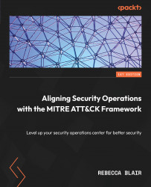


推薦閱讀
https://www.tenlong.com.tw/products/9787111703068?list_name=srh
ATT&CK 三個關鍵工具
https://www.tenlong.com.tw/products/9786267146316?list_name=srh

Slide 141
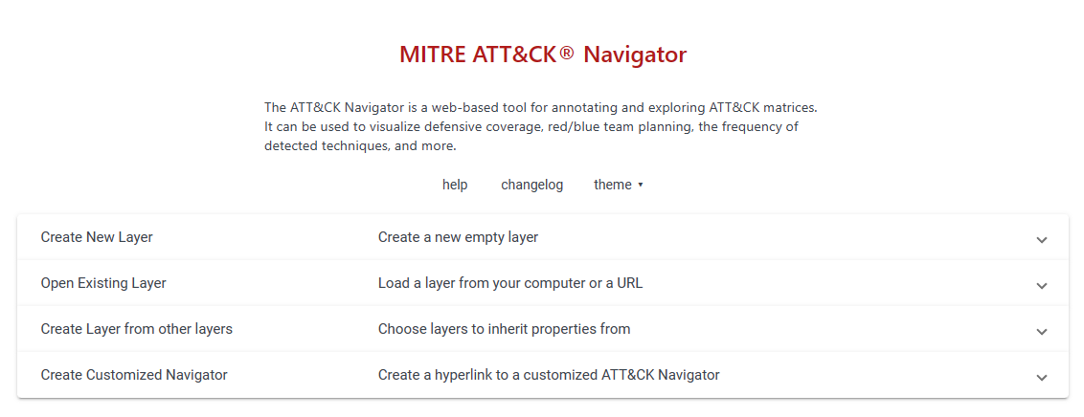
MITRE ATT&CK® Navigator
https://mitre-attack.github.io/attack-navigator/

Slide 142
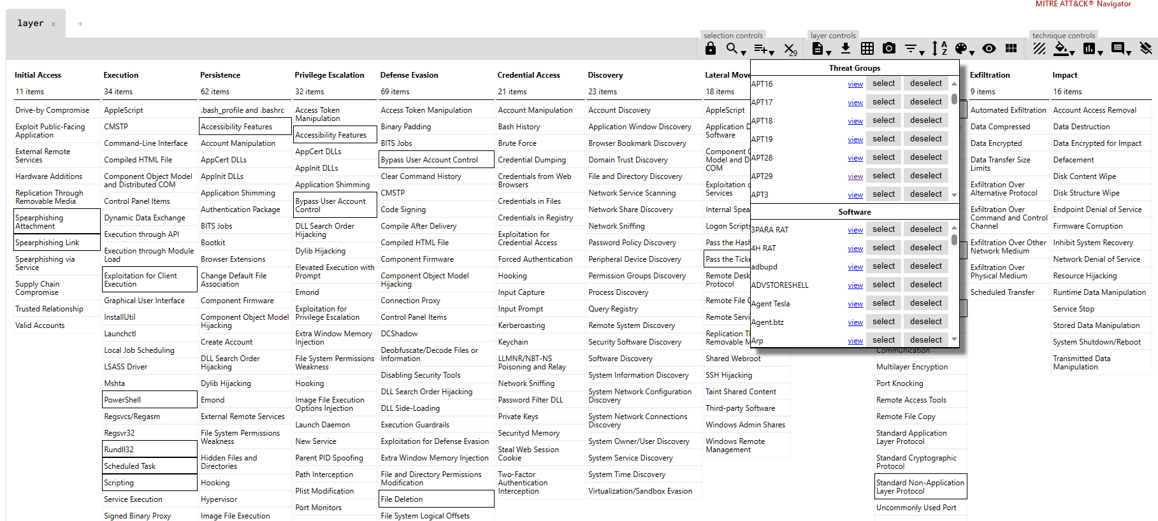

Slide 143
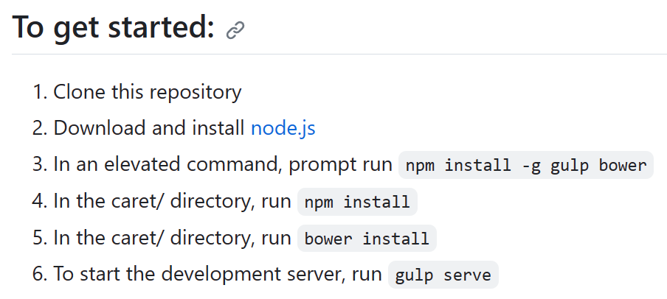
Cyber Analytic Repository Exploration Tool (CARET)
https://github.com/mitre/caret
The Cyber Analytic Repository Exploration Tool (CARET) is a proof-of-concept graphical user interface designed to connect the groups and techniques highlighted in ATT&CK™ to the analytics, data model, and sensors highlighted in MITRE's Cyber Analytics Repository (CAR). 0
CARET is used to develop an understanding of defensive capabilities and to aid in their development and use.

Slide 144
TRAM | Threat Report ATT&CK® Mapping
https://github.com/center-for-threat-informed-defense/tram/
Threat Report ATT&CK Mapper (TRAM) is an open-source platform designed to to reduce cost and increase the effectiveness of integrating ATT&CK across the CTI community.
It does this by automating the mapping of cyber threat intelligence (CTI) reports to MITRE ATT&CK®. Threat intel providers, threat intel platforms, and analysts can use TRAM to integrate ATT&CK more easily and consistently into their products.
The platform works out of the box to identify up to 50 common ATT&CK techniques in text documents;
it also supports tailoring the model by annotating additional items and rebuilding the model.
This Wiki describes the results of the Center for Threat-Informed Defense (CTID) research into automated ATT&CK mapping and provides details and instructions for tailoring the platform to your organization's unique dataset.

Slide 145
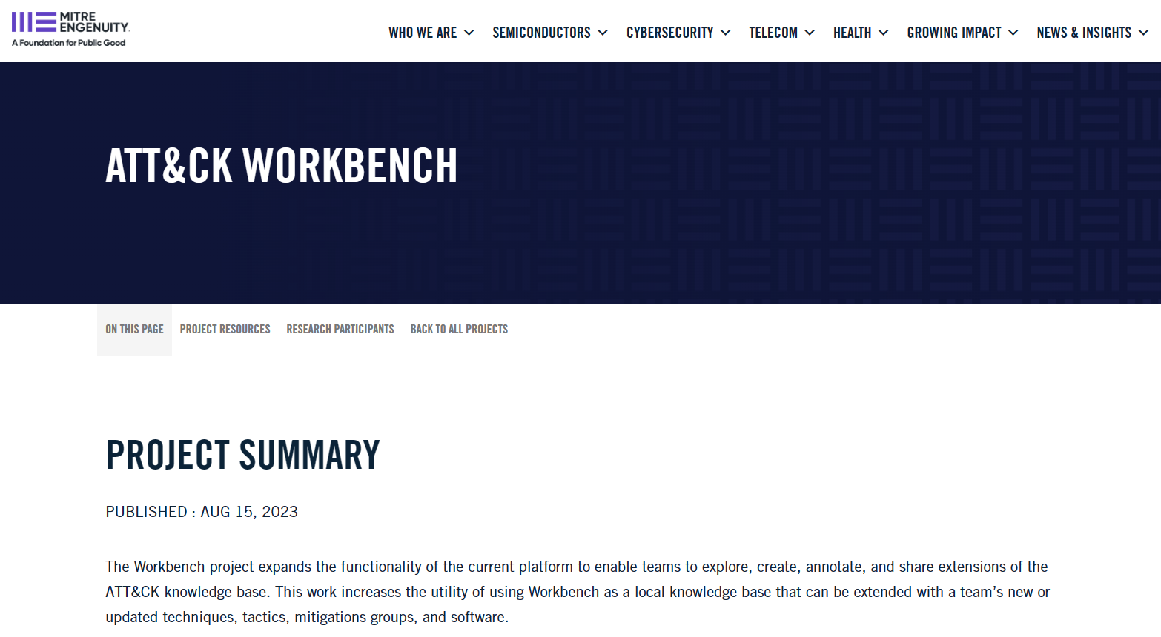
ATT&CK Workbench https://mitre-engenuity.org/cybersecurity/center-for-threat-informed-defense/our-work/attck-workbench/

Slide 146

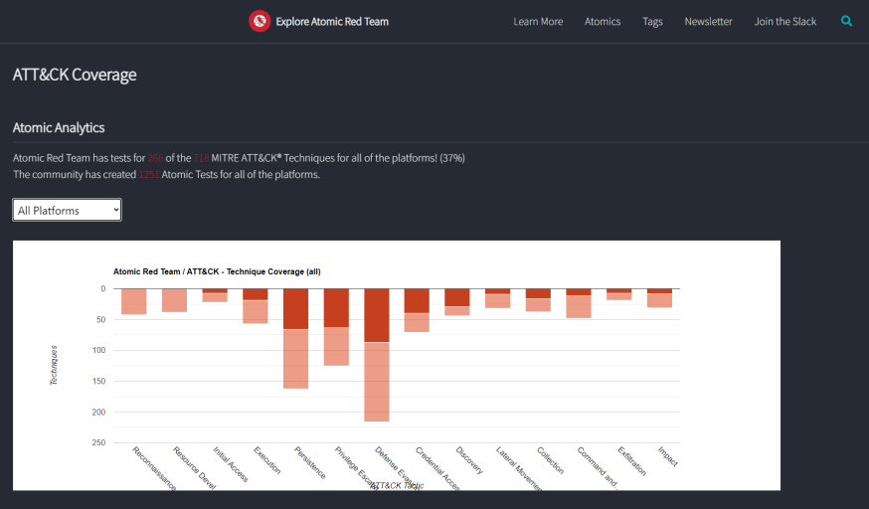
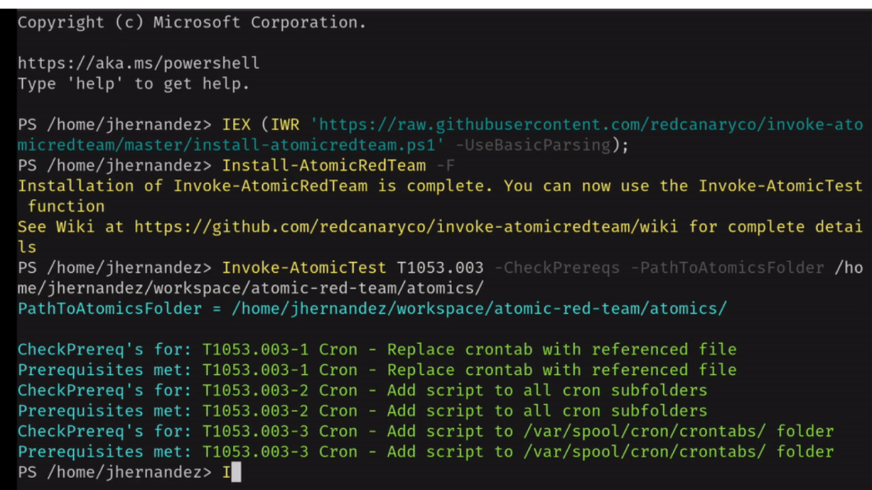
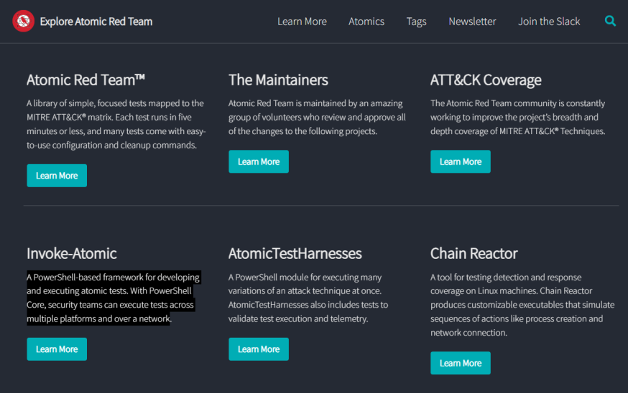
https://github.com/redcanaryco/atomic-red-team
https://atomicredteam.io/coverage/
Red Canary’s Invoke-AtomicRedTeam PowerShell Testing Framework
Atomic Red Team
Atomic Red Team™ is a library of tests mapped to the MITRE ATT&CK® framework.
Security teams can use Atomic Red Team to quickly, portably, and reproducibly test their environments.
https://github.com/redcanaryco/atomic-red-team/wiki/

Slide 147
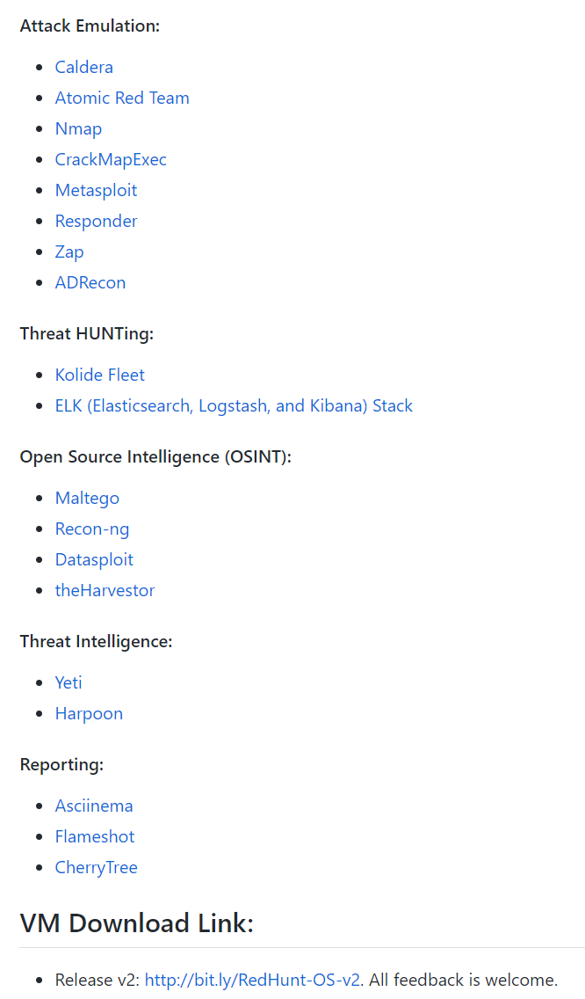

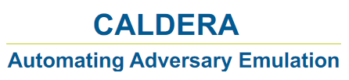

MITRE ATT&CK 自動化攻擊模擬平臺
https://github.com/redhuntlabs/RedHunt-OS
Open Source Adversary Emulation Tools:
https://pentestit.com/adversary-emulation-tools-list

Slide 148
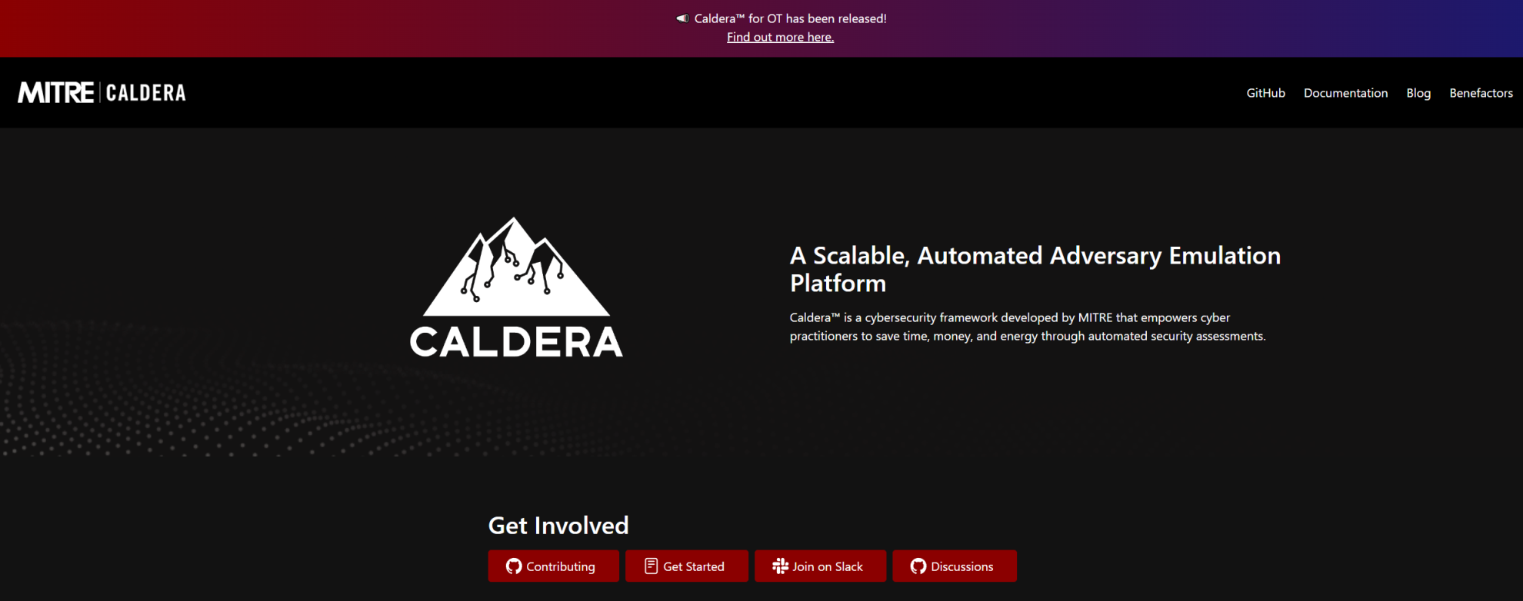
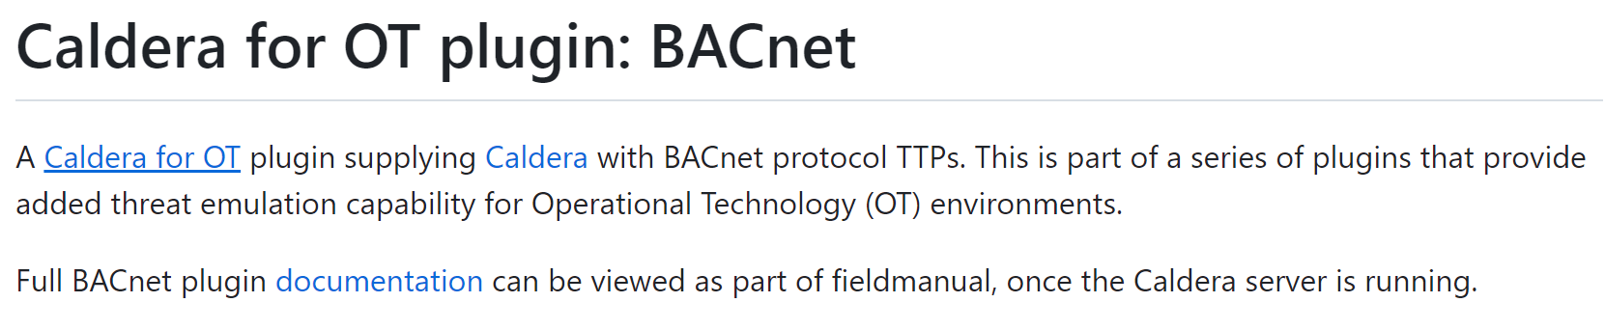
OT security
https://github.com/mitre/bacnet/tree/745432cc3aa01c8de481dec063b6ccf02f601247

Slide 149
推薦閱讀 Aligning Security Operations with the MITRE ATT&CK Framework
Part 1 – The Basics: SOC and ATT&CK, Two Worlds in a Delicate Balance
Chapter 1: SOC Basics – Structure, Personnel, Coverage, and Tools
Chapter 2: Analyzing Your Environment for Potential Pitfalls
Chapter 3: Reviewing Different Threat Models
Chapter 4: What Is the ATT&CK Framework?
Part 2 – Detection Improvements and Alignment with ATT&CK
Chapter 5: A Deep Dive into the ATT&CK Framework
Chapter 6: Strategies to Map to ATT&CK
Chapter 7: Common Mistakes with Implementation
Chapter 8: Return on Investment Detections
Part 3 – Continuous Improvement and Innovation
Chapter 9: What Happens After an Alert is Triggered?
Chapter 10: Validating Any Mappings and Detections
Chapter 11: Implementing ATT&CK in All Parts of Your SOC
Chapter 12: What’s Next? Areas for Innovation in Your SOC

Slide 150
reference

Slide 151
網路服務阻斷 Network Denial of Service
https://attack.mitre.org/techniques/T1498/
Sub-techniques (2)
ID | Name
T1498.001 | Direct Network Flood
T1498.002 | Reflection Amplification
Adversaries(攻擊者)可能會執行網路服務阻斷 (DoS) 攻擊，以降低或阻止目標資源的可用性(availability)。
網路 DoS 可以通過耗盡服務所依賴的網路帶寬來執行。
Adversaries(攻擊者)目的 == >出於政治目的和支持其他惡意活動(包括分散注意力、黑客行動主義和勒索)而進行網路 DoS 攻擊。
分佈式 DoS (DDoS) A distributed denial of service (DDoS) attack is launched from numerous compromised devices, often distributed globally in what is referred to as a botnet
執行網路 DoS 攻擊的幾個方面適用於多種方法，包括 IP 地址欺騙和殭屍網路
Adversaries(攻擊者)可能會使用攻擊系統的原始 IP 地址，或偽造源 IP 地址，使攻擊流量更難追溯到攻擊系統
ID | Name | Description
G0007 | APT28 | In 2016, APT28 conducted a distributed denial of service (DDoS) attack against the World Anti-Doping Agency.
S0532 | Lucifer | Lucifer can execute TCP, UDP, and HTTP denial of service (DoS) attacks.

Slide 152
Mitigations 緩解措施
ID | Mitigation | Description
M1037 | Filter Network Traffic | When flood volumes exceed the capacity of the network connection being targeted, it is typically necessary to intercept the incoming traffic upstream to filter out the attack traffic from the legitimate traffic. Such defenses can be provided by the hosting Internet Service Provider (ISP) or by a 3rd party such as a Content Delivery Network (CDN) or providers specializing in DoS mitigations. Depending on flood volume, on-premises filtering may be possible by blocking source addresses sourcing the attack, blocking ports that are being targeted, or blocking protocols being used for transport. As immediate response may require rapid engagement of 3rd parties, analyze the risk associated to critical resources being affected by Network DoS attacks and create a disaster recovery plan/business continuity plan to respond to incidents.
Detection偵測
ID | Data Source | Data Component | Detects
DS0029 | Network Traffic | Network Traffic Flow | Monitor network data for uncommon data flows. Processes utilizing the network that do not normally have network communication or have never been seen before are suspicious.
DS0013 | Sensor Health | Host Status | Detection of Network DoS can sometimes be achieved before the traffic volume is sufficient to cause impact to the availability of the service, but such response time typically requires very aggressive monitoring and responsiveness or services provided by an upstream network service provider. Monitor for logging, messaging, and other artifacts highlighting the health of host sensors (ex: metrics, errors, and/or exceptions from logging applications)

Slide 153
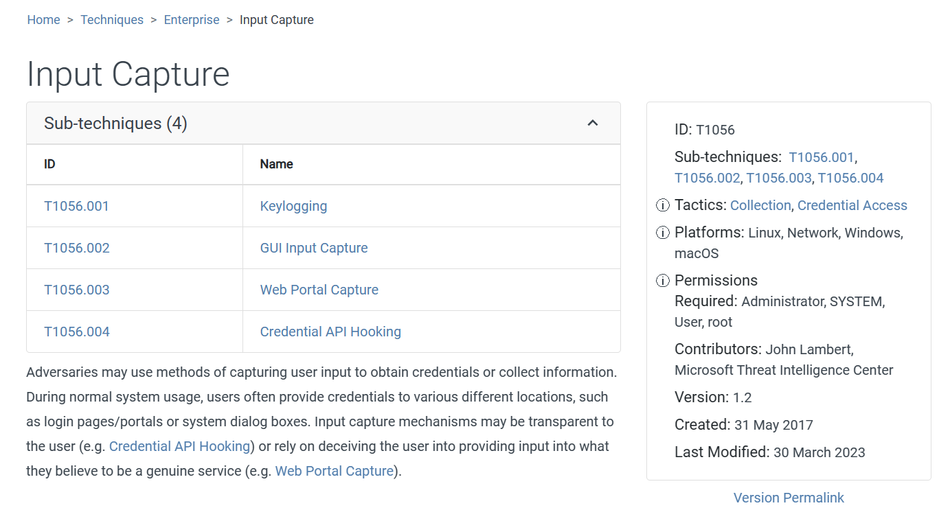

Slide 154
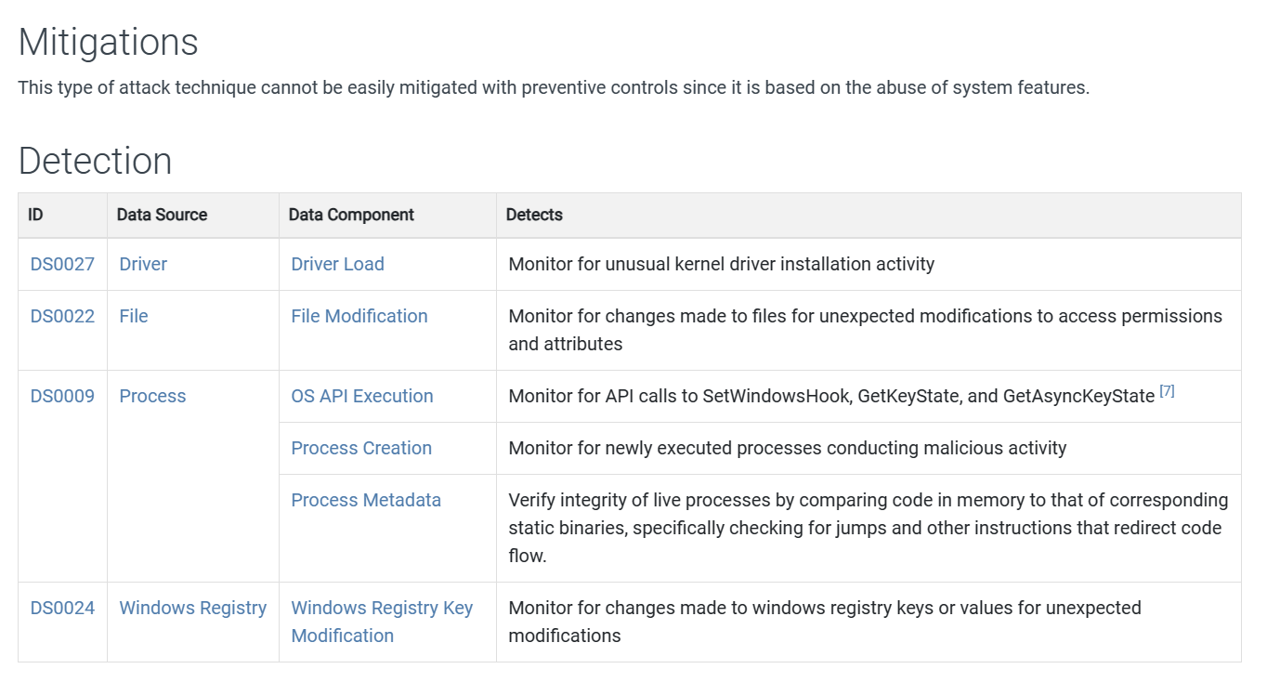

Slide 155
c | 1. | 在Cyber Kill Chain 模型中，Delivery 階段通常包括下列何項攻擊手法？ (A) 惡意軟體安裝 (B) 網站水坑攻擊 (C) 電子郵件附件或內文URL 連結 (D) 帳號密碼填充攻擊
abc | 2. | 關於MITRE ATT&CK 中的瀏覽器會話劫持（Browser SessionHijacking）技術，下列哪些正確？（複選） (A) 可透過資安認知訓練（Awareness Training）來緩解此技術 (B) 可分析登入會話（Logon Session）的產生狀態來偵測此技術 (C) 可透過使用者帳戶管理（User Account Management）來緩解此技術 (D) 僅能透過分析程序存取（Process Access）與程序修改（Process Modification）狀態來偵測此技術

